Slide 1
“I AM…”
John 8:12; John 14:6; John 11:25-26

Slide 2
I AM… Ex. 3:14
I am the Gate John 10:9
I am the Good Shepherd John 10:11

Slide 3
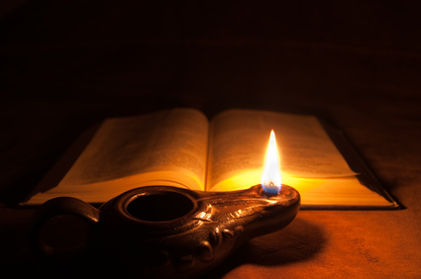
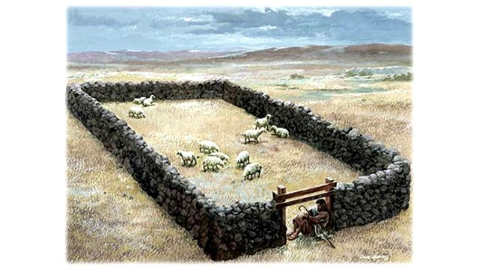
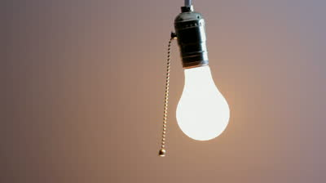
IV. I am the light of the World

Slide 4
John 8:12 Then spake Jesus again unto them, saying, I am the light of the world: he that followeth me shall not walk in darkness, but shall have the light of life.
Psalms 119:105 Thy word is a lamp unto my feet, and a light unto my path.
John 1:5 And the light shineth in darkness; and the darkness comprehended it not.

Slide 5
What is your darkness? Jesus has the answer!
Stress, Depress, Discourage?
Philippians 4:4 Rejoice in the Lord alway: and again I say, Rejoice.
Burdened or guilty?
2 Corinthians 12:9 And he said unto me, My grace is sufficient for thee: for my strength is made perfect in weakness.

Slide 6
Money Problems?
Luke 6:38 Give, and it shall be given unto you; good measure, pressed down, and shaken together, and running over, shall men give into your bosom. For with the same measure that ye mete withal it shall be measured to you again.
Health Problems?
James 5:16 Confess your faults one to another, and pray one for another, that ye may be healed. The effectual fervent prayer of a righteous man availeth much.

Slide 7
I am the light of the world

Slide 8
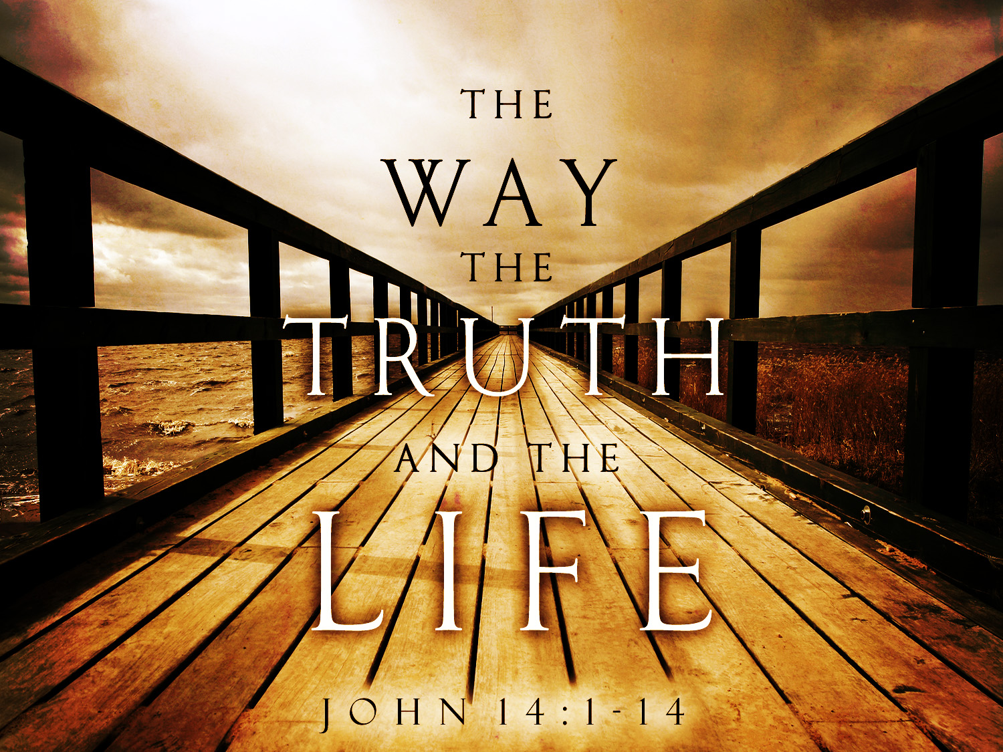
V. I am the way, the truth and the life

Slide 9
John 14:6 Jesus saith unto him, I am the way, the truth, and the life: no man cometh unto the Father, but by me.
Acts 4:12 Neither is there salvation in any other: for there is none other name under heaven given among men, whereby we must be saved.
Salvation in no other!

Slide 10
I am the light of the world
I am the way the truth and life

Slide 11
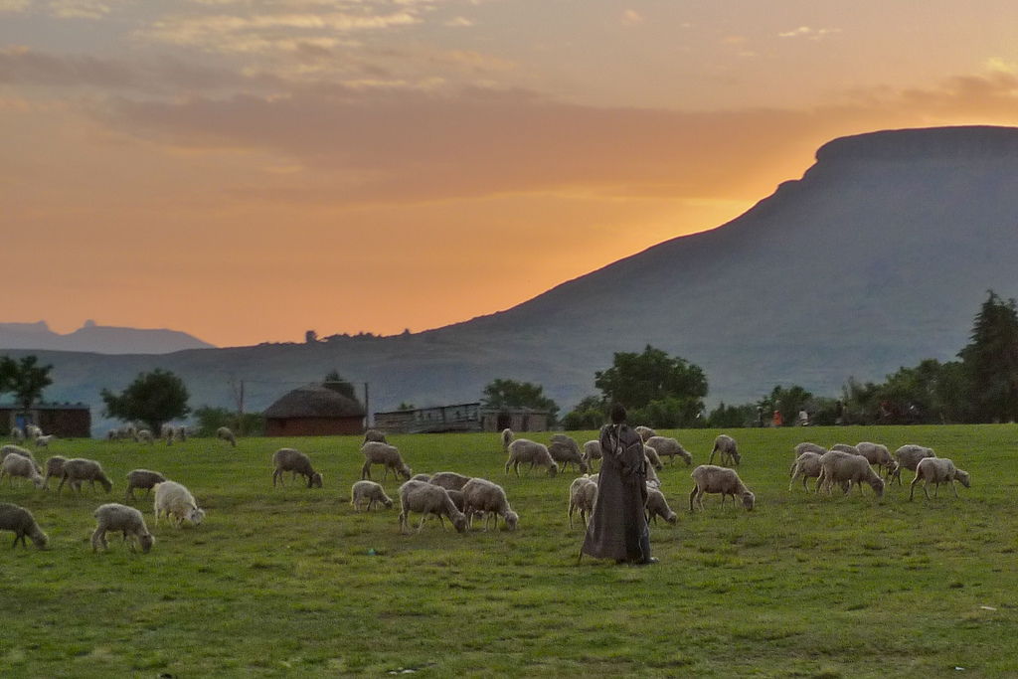
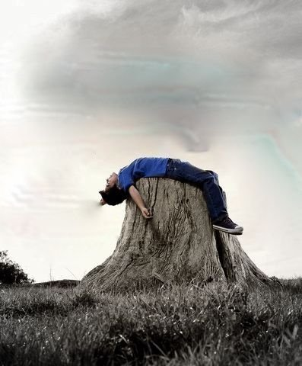
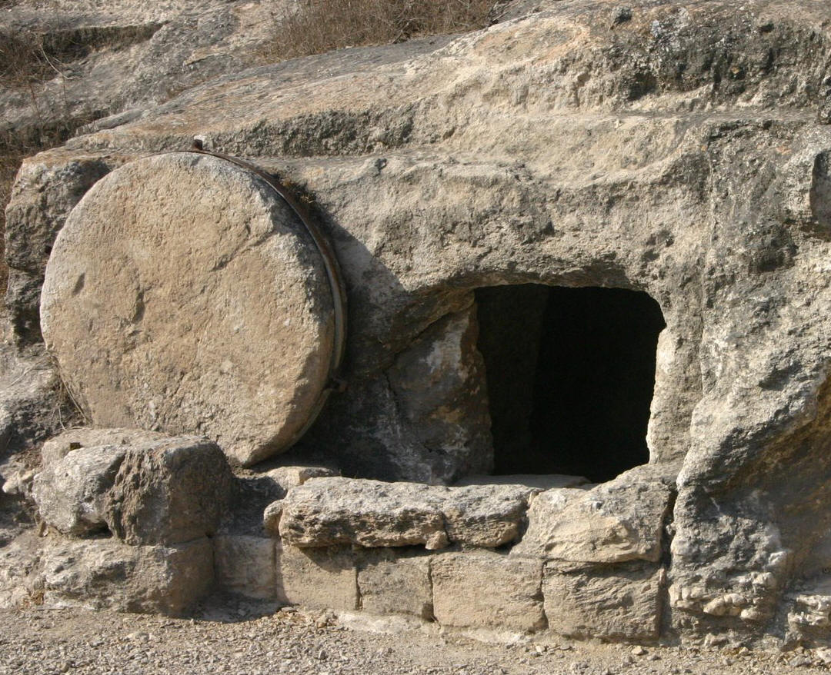
VI. I am the resurrection and the life

Slide 12
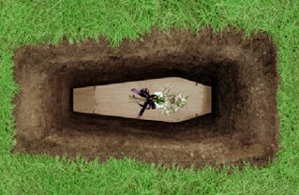
John 11:25-26 Jesus said unto her, I am the resurrection, and the life: he that believeth in me, though he were dead, yet shall he live: And whosoever liveth and believeth in me shall never die.
Hebrews 9:27 And as it is appointed unto men once to die, but after this the judgment:

Slide 13
I am the light of the world
I am the way, truth, life
I am the resurrection and life

Slide 14
The Bible requires a response:
He is the light of the world – Do you take his light?
He is the way the truth and the life – Are you on that path?
He is the resurrection and the life – Who are you telling?

Slide 15
John 10:11-14 (11) I am the good shepherd: the good shepherd giveth his life for the sheep. (12) But he that is an hireling, and not the shepherd, whose own the sheep are not, sees the wolf coming, and leaves the sheep, and flees: and the wolf catches them, and scatters the sheep. (13) The hireling flees, because he is an hireling, and cares not for the sheep. (14) I am the good shepherd, and know my sheep, and am known of mine.

Slide 16
What about you?
Have you accepted Jesus as your Savior?
Is your life filled with his light?
Are you living in the reality of death?

