Slide 1
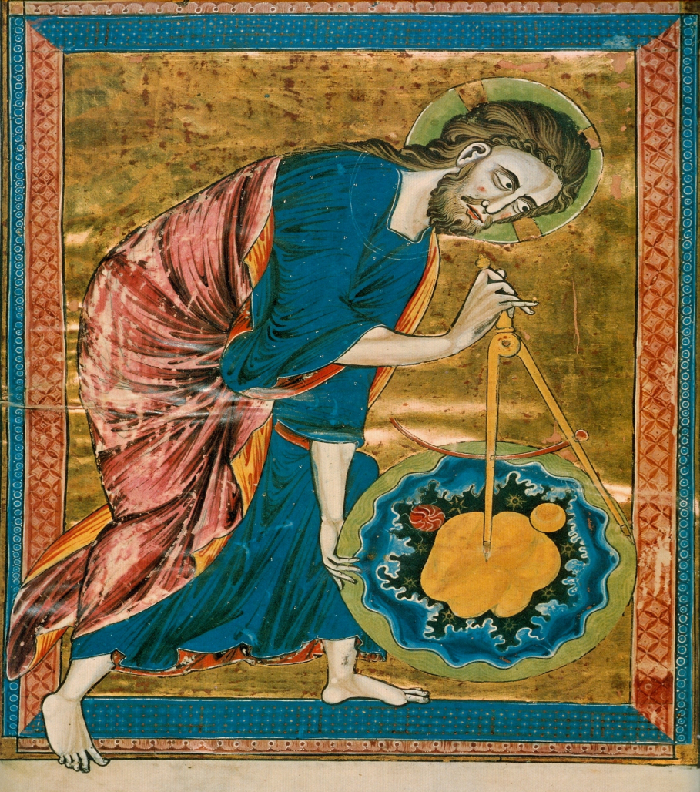
The Word
Deaf Liberty Baptist Church
Sunday, September 29, 2013
Bro. Clark H. Corogenes

Slide 2
Worship Gatherings
Pleasing Open Your:
-Heart
-Spirit
-Mind
Asking the Lord for Leading:
-Your Needs.
-Your Relationships with Christ.
-Forgiveness and Reconditions.
Gifting to the Lord:
-Your Thanks and Glories.
-Your Praising and Honoring.

Slide 3
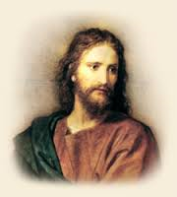
Eternal Word and God
John 1: 1-2
In the beginning was the Word, and the Word was with God, and the Word was God.
The same was in the beginning with God.
Introducing the Word with God.
Greek (Logos)
Identifying the Jesus Christ.

Slide 4
Eternal Word and Creation
John 1:3-5
God created everything through him,
and nothing was created except through him.
The Word gave life to everything that was created, and his life brought light to everyone.
The light shines in the darkness, and the darkness can never extinguish it.
Jesus Christ is the Light and the Word of God.

Slide 5
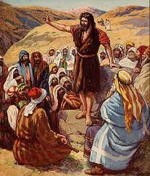
Eternal Word and Light
John 1: 6-9
God sent a man, John the Baptist,
to tell about the light so that everyone might believe because of his testimony.
John himself was not the light; he was simply a witness to tell about the light.
The one who is the true light, who gives light to everyone, was coming into the world.

Slide 6
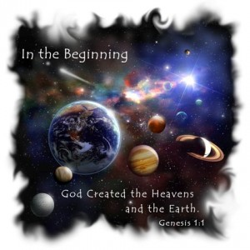
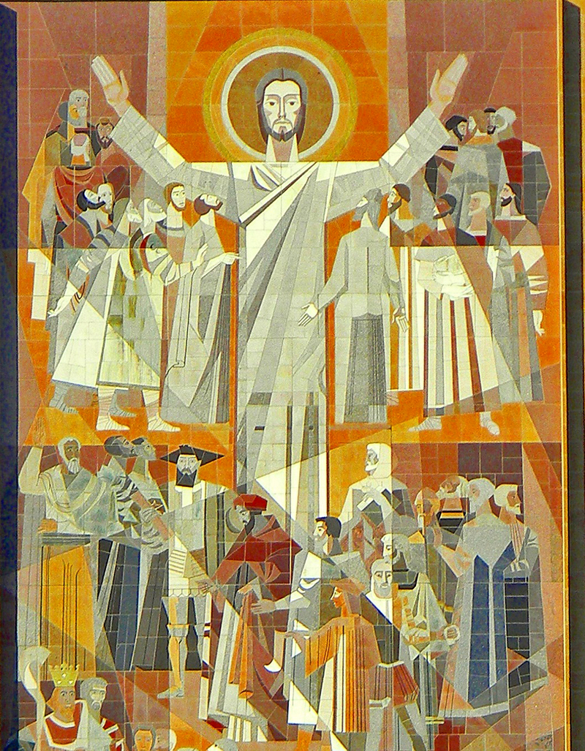
Commanding the Word
Eternal Word
Your eternal word, O LORD, stands firm in heaven.
Psalms 119: 89
Powerful Word
The Lord merely spoke, and the heavens were created. He breathed the word.
For when he spoke, the world began! It appeared at his command.
Psalms 33: 6; 9
Word of Life
We proclaim to you the one who existed from the beginning, whom we have heard and seen. We saw him with our own eyes and touched him with our own hands. He is the Word of life.
1 John 1: 1

