Slide 1
Transforming by Problems and Trials
Deaf Liberty Baptist Church
Sunday, August 25, 2013
Bro. Clark H. Corogenes

Slide 2
Perseverance
Because of our faith, Christ has brought us into this place of undeserved privilege where we now stand, and we confidently and joyfully look forward to sharing God’s glory.
We can rejoice, too, when we run into problems and trials, for we know that they help us develop endurance.
Romans 5: 2-3

Slide 3
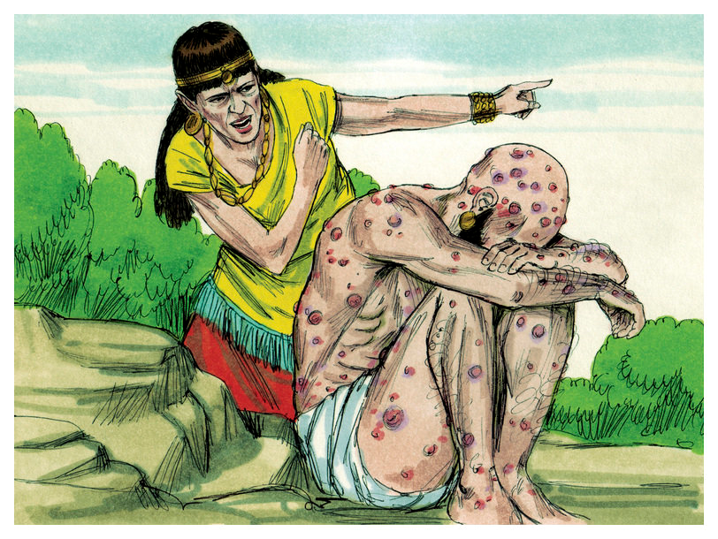
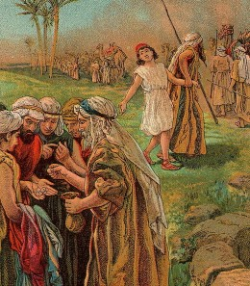
Good Example of Perseverance
JOB
JOSEPH

Slide 4
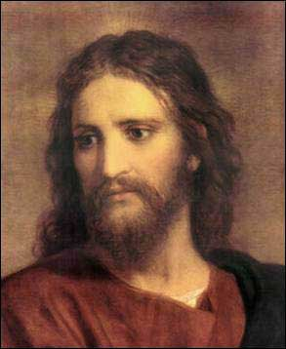
Character
And endurance develops strength of character, and character strengthens our confident hope of salvation.
Romans 5:4
CHRIST LIKENESS
FRUIT of the Spirit

Slide 5
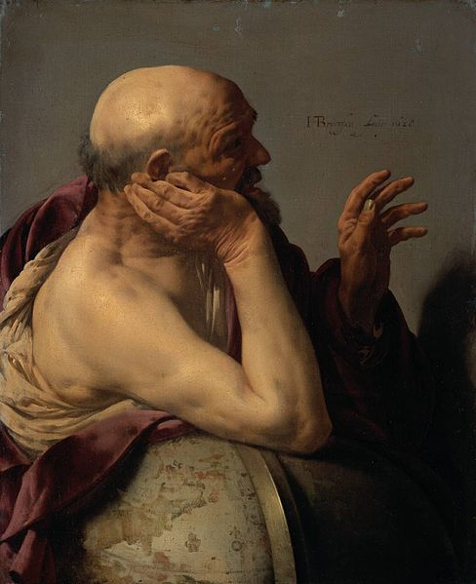
Good Example of Character
“Good Character is not formed in a week or a month. It is created little by little, day by day. Protracted and Patient effect is needed to develop good character.”
Ancient Greek Philosopher
Heraclitus (535 to 575 BC)

Slide 6
Hope
And this hope will not lead to disappointment. For we know how dearly God loves us, because he has given us the Holy Spirit to fill our hearts with his love.
Romans 5:5
Hebrews 6: 19

Slide 8
Fear or Faith
It does not rejoice about injustice but rejoices whenever the truth wins out. Love never gives up, never loses faith, is always hopeful, and endures through every circumstance.
1 Corinthians 13: 6-7

