Slide 1
Bearing Your Act of Fruit
Sunday, June 30, 2013
Deaf Liberty Baptist Church
Bro. Clark H. Corogenes

Slide 2
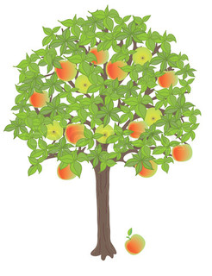
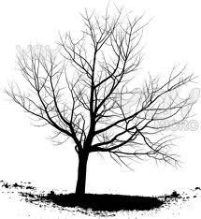
Life of Faithful or Faithless
But they delight in the law of the Lord, meditating on it day and night.
They are like trees planted along the riverbank, bearing fruit each season.
Their leaves never wither, and they prosper in all they do.
But not the wicked! They are like worthless chaff, scattered by the wind.
They will be condemned at the time of judgment.
Sinners will have no place among the godly. For the Lord watches over the path of the godly, but the path of the wicked leads to destruction.
Psalm 1:2-6

Slide 3
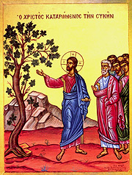
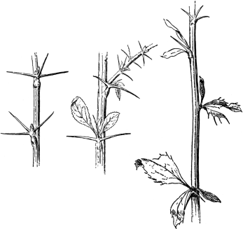
Known by Your Fruit
You can identify them by their fruit, that is, by the way they act. Can you pick grapes from thorn bushes, or figs from thistles?
A good tree produces good fruit, and a bad tree produces bad fruit.
A good tree can’t produce bad fruit, and a bad tree can’t produce good fruit.
So every tree that does not produce good fruit is chopped down and thrown into the fire.
Yes, just as you can identify a tree by its fruit, so you can identify people by their actions.
Matthew 7:16-20
Thorn Bushes
Thistles

Slide 4
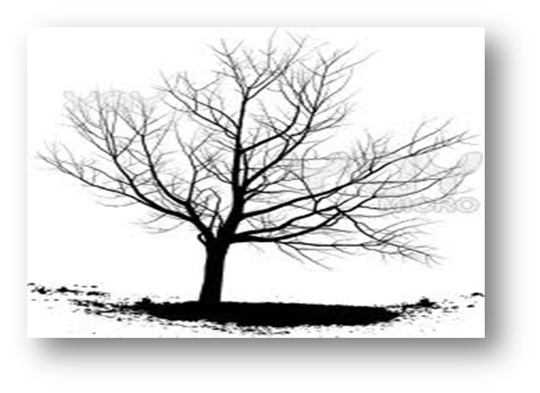
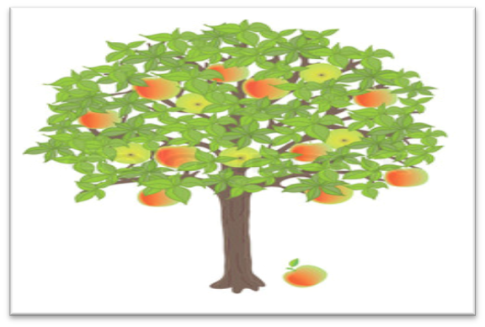
Act of Fruit
Evil of fruits
Good of Fruits
When you follow the desires of your sinful nature, the results are very clear:
Sexual immorality
Impurity
lustful pleasures
Idolatry
Sorcery
Hostility
Quarreling
Jealousy
Outbursts of Anger
Selfish Ambition
Dissension
Division
Envy
Drunkenness
The Holy Spirit produces this kind of fruit in our lives:
Love
Joy
Peace
Patience
Kindness
Goodness
Faithfulness
Gentleness
Self-Control
Galatians 5: 19-23

Slide 5
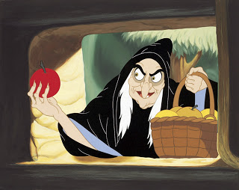
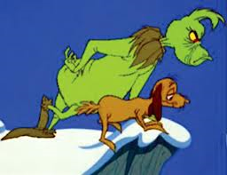
Great Examples
Witchcraft
-Walt Disney's 1937 film Snow White and the Seven Dwarfs.
-Grimm's Fairy Tales by Grimm brothers, Jacob and Wilhelm.
Evil Queen and Stepmother
Transformed to the Witchcraft
The Poisoned Apple:
Drugs, Money, Bitterness, Sinful, Alcoholics, Destroyer, Hateful, Lusts, Materialism, Lairs, Broken Trusts or Relationships, Prides, Bully, Ego, Enemies, and Back Stabbing.
Grinch
-1957 children's book, How the Grinch Stole Christmas!
-Dr. Seuss' How the Grinch Stole Christmas (film)
Hatefully
Greedy
Bitterness

Slide 6
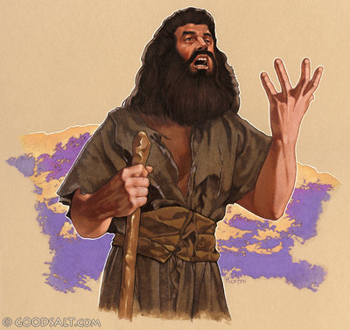
Repenting for Your Fruit and Turn to God
"Therefore bear fruit in keeping with repentance;
Matthew 3: 8
John the Baptist
I pray that your love will overflow more and more, and that you will keep on growing in knowledge and understanding. For I want you to understand what really matters, so that you may live pure and blameless lives until the day of Christ’s return. May you always be filled with the fruit of your salvation the righteous character produced in your life by Jesus Christ for this will bring much glory and praise to God.
Philippians 1: 9-11

