Slide 1
CELEBRATING PENTECOST
Full of the Holy Spirit and Faith
May 19, 2013
Deaf Liberty Baptist Church
Bro. Clark H. Corogenes

Slide 2
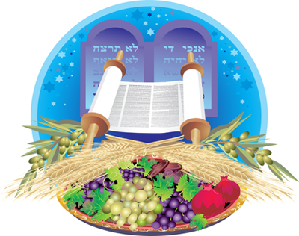
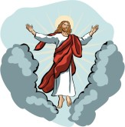
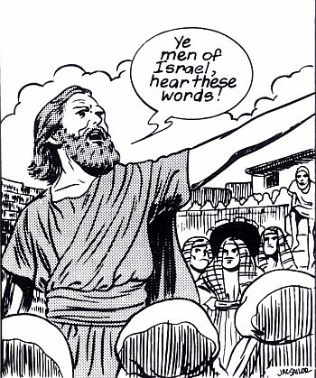
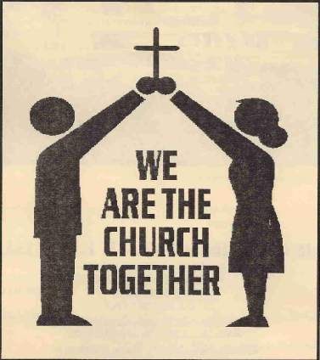
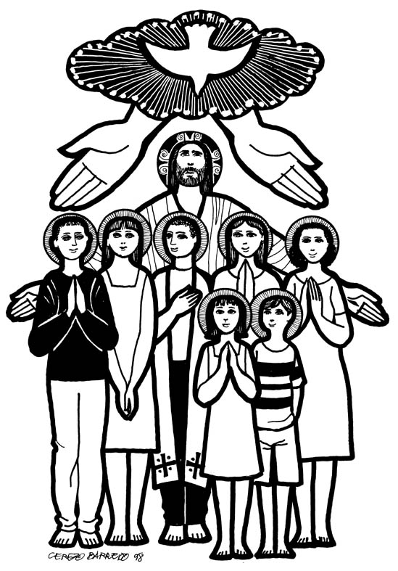
PENTECOST after Christ’s resurrection, the Holy Spirit uniquely came upon believers and spread of Christianity to the world.
50 days to Jewish celebration of harvest (Shavuot)
Ascension of Christ.
First spread of the Gospel.
First spread of Missionary.
Church was born.
Christian was born.

Slide 3
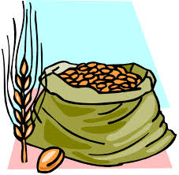
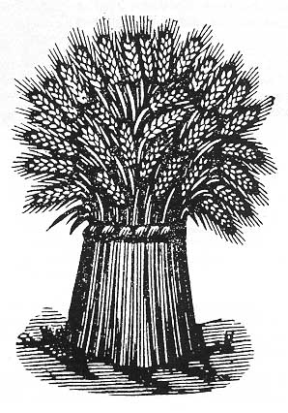
Jewish Celebration of Harvest
Shavuot : Festival of First Harvest and Burnt Offerings to the Lord. 50 days after Passover.
-New grain and Liquid
Leviticus 23: 22
“When you harvest the crops of your land, do not harvest the grain along the edges of your fields, and do not pick up what the harvesters drop. Leave it for the poor and the foreigners living among you. I am the Lord your God.”
-Examples of Joseph and Ruth
-Comparing with Pentecost ?

Slide 4
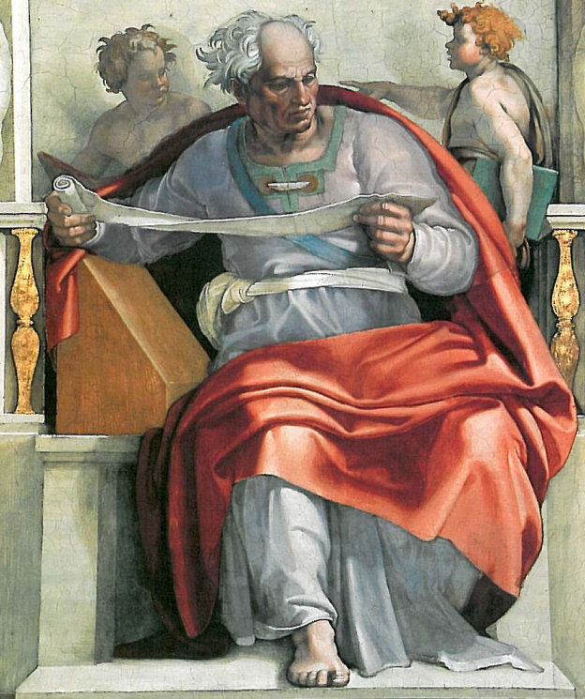
Fulfilled Prophecy of Pentecost
I will pour out my Spirit on all people. Your sons and daughters will prophesy, your old men will dream dreams, your young men will see visions.
Even on my servants, both men and women, I will pour out my Spirit in those days. I will show wonders in the heavens
Joel 2: 38-30
JOEL, Minor Prophets
The Israel of People
800 B.C. or 430 B.C.

Slide 5
The Holy Spirit Comes
He brought this Good News of peace to you Gentiles who were far away from him, and peace to the Jews who were near.
Now all of us can come to the Father through the same Holy Spirit because of what Christ has done for us.
Ephesians 2 :17-18

Slide 6
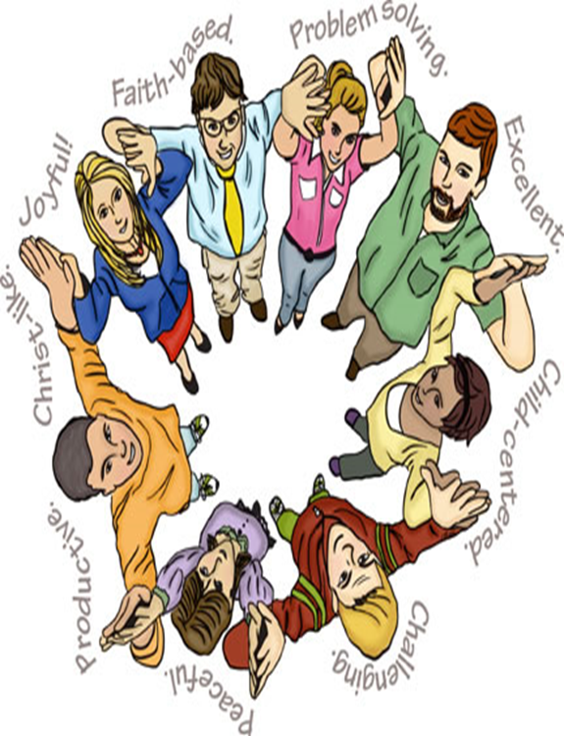
You are Citizens of God’s Kingdom
So now you Gentiles are no longer strangers and foreigners. You are citizens along with all of God’s holy people. You are members of God’s family.
Together, we are his house, built on the foundation of the apostles and the prophets. And the cornerstone is Christ Jesus himself.
Ephesians 2:19-20

Slide 7
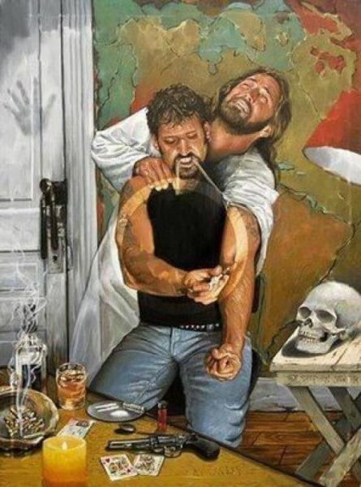
Temple of the Holy Spirit
Don’t you realize that your body is the temple of the Holy Spirit, who lives in you and was given to you by God?
You do not belong to yourself, for God bought you with a high price. So you must honor God with your body.
1 Corinthians 6:19-20

Slide 8
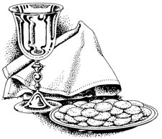
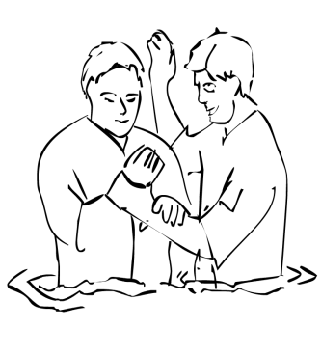
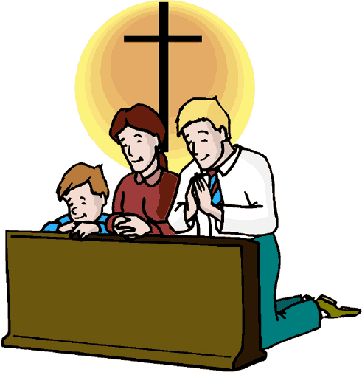
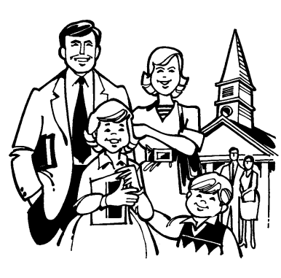
The Believers Share
Church
Providing Worship, Word of God, Apostles’ Doctrine, Discipline, Praise, Song, Fellowship, Baptism, Breaking of Cup and Bread and Prayers.
Acts : 42-47

