Slide 1
HE IS RISEN

Slide 2
Happy Easter
Celebrating the Resurrection of Jesus Christ
Sunday, March 31, 2013
Bro. Clark H. Corogenes

Slide 3
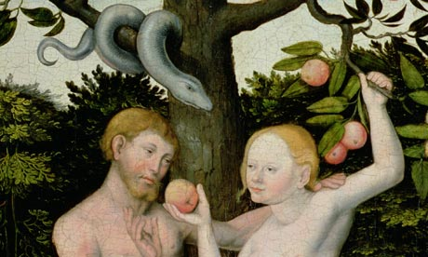
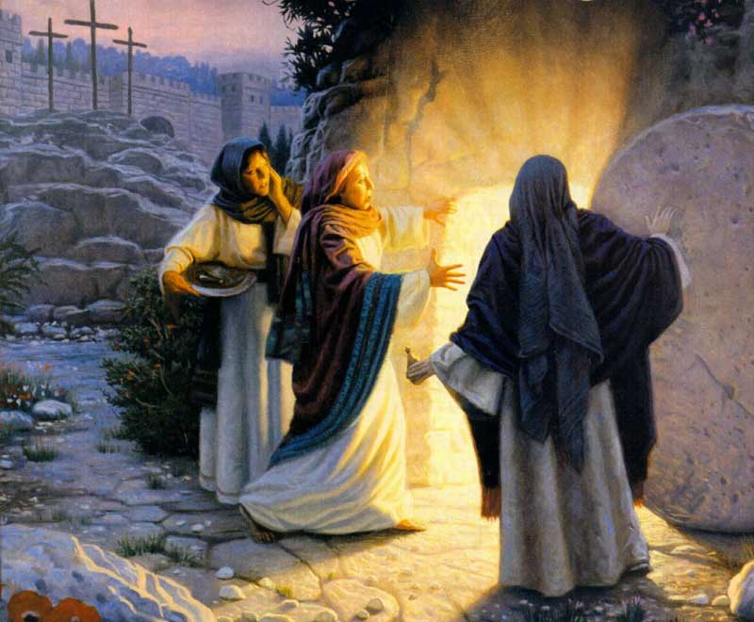
“Frist Adam and Last Adam”
The Scriptures tell us, “The first man, Adam, became a living person.”
But the last Adam—that is, Christ—is a life-giving Spirit.
1 Corinthians 15: 45

Slide 4
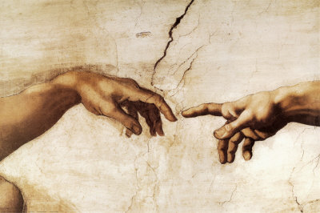
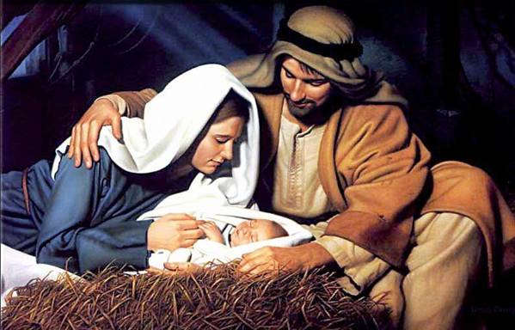
Adam and Christ
Dust of the Earth.
A Living Person.
Foundered of the Human Race.
-Genesis 2:7
Then the Lord God formed the man from the dust of the ground. He breathed the breath of life into the man’s nostrils, and the man became a living person.
From the Heaven.
A Life-Giving Spirit.
Initiated a New Spiritual Man.
-Matthew 1:18
This is how Jesus the Messiah was born. His mother, Mary, was engaged to be married to Joseph. But before the marriage took place, while she was still a virgin, she became pregnant through the power of the Holy Spirit.

Slide 5
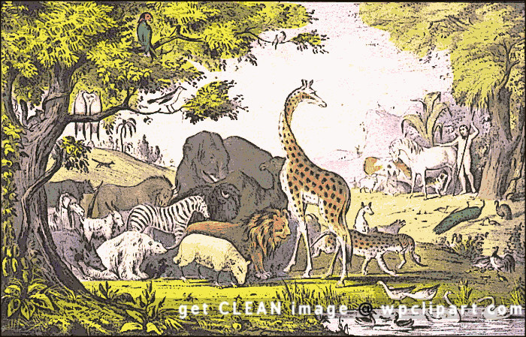
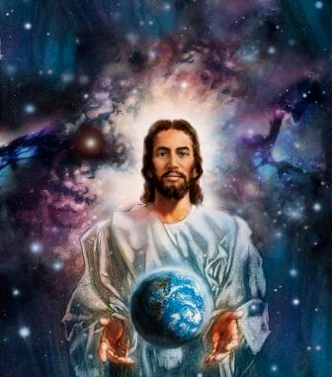
Adam and Christ
Domain over all the creatures.
-Genesis 1:26
They will reign over the fish in the sea, the birds in the sky, the livestock, all the wild animals on the earth, and the small animals that scurry along the ground.”
Domain over all the Creation.
-Ephesians 1:20-22
that raised Christ from the dead and seated him in the place of honor at God’s right hand in the heavenly realms. Now he is far above any ruler or authority or power or leader or anything else not only in this world but also in the world to come. God has put all things under the authority of Christ and has made him head over all things for the benefit of the church.

Slide 6
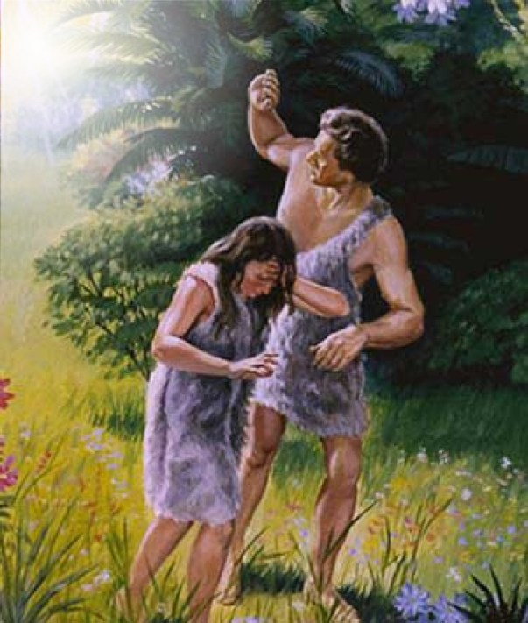
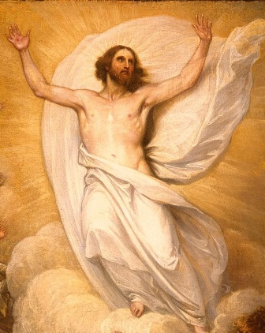
Adam and Christ
A Great Failure.
Sin = Broken Fellowship with the God’s Love.
Hubris = Pride and Equality the God’s Power.
Death = led to the Darkness and the Punishment.
-Romans 5:12
When Adam sinned, sin entered the world. Adam’s sin brought death, so death spread to everyone, for everyone sinned.
A Great Victory.
Righteousness = Reconciliation.
Sacrifice = Propitiation and Forgiveness.
Eternal Life = A Gift of God : Salvation.
-1 Corinthians 15:57
But thank God! He gives us victory over sin and death through our Lord Jesus Christ.

Slide 7
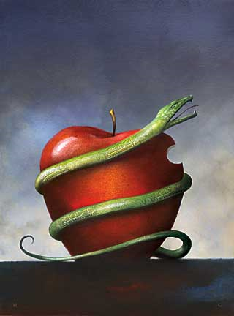
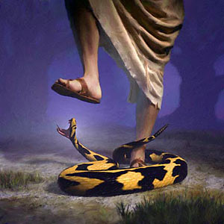
Adam and Christ
Cursed
Bondage of sin and death.
-Genesis 3:15
And I will put enmity between you and the woman, and between your offspring and hers; he will crush your head, and you will strike his heel.”
Restoration
Ruling the Kingdom of God.
-1 Corinthians 15:26-27
The last enemy to be destroyed is death. For he “has put everything under his feet.” Now when it says that “everything” has been put under him, it is clear that this does not include God himself, who put everything under Christ.

Slide 8
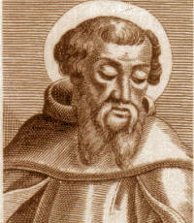
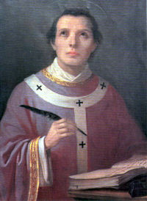
Adam and Christ
Irenaeus Bishop of Lyons
Anselm Archbishop of Centerburg
He was a follower of Polycarp who under Apostle John.
One of the Early Fathers of the Church.
A Strong Christian Apologist, 125-200 AD.
Opposed Heresies and the False Teachings (Gnosticism).
“Christus Victor: Model of the Atonement.”
-Romans 5:19
Because one person disobeyed God, many became sinners. But because one other person obeyed God, many will be made righteous.
One of England’s Greatest Philosophers and Theologians.
A Monk and Christian Scholar.
Serviced under First William King of England, 1066 AD.
“Satisfaction Theory of the Atonement.”
- 2 Corinthians 5:19
For God was in Christ, reconciling the world to himself, no longer counting people’s sins against them. And he gave us this wonderful message of reconciliation.

