Slide 1
What The Lord Wants
January 20, 2013
Deaf Liberty Baptist Church
Bro. Clark H. Corogenes

Slide 2
A Great Hero of Faith
Genesis 5: 22-24
-Enoch walked faithfully with God 300 years and had other sons and daughters.
-Altogether, Enoch lived a total of 365 years.
-Enoch walked faithfully with God; then he was no more, because God took him away.
Hebrews 11:5-6
-By faith Enoch was taken from this life, so that he did not experience death: “He could not be found, because God had taken him away.” For before he was taken, he was commended as one who pleased God.
-And without faith it is impossible to please God, because anyone who comes to him must believe that he exists and that he rewards those who earnestly seek him.

Slide 3
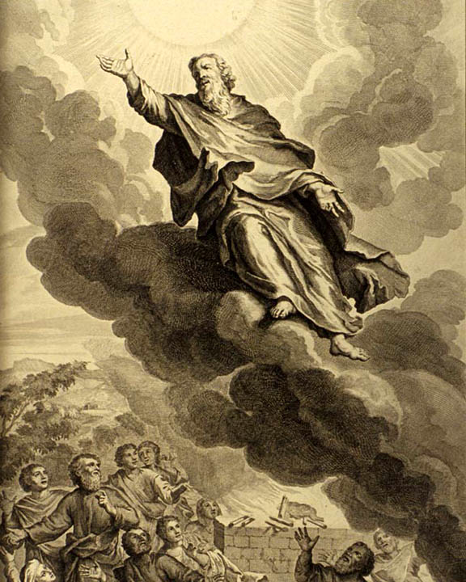
WALKING WITH The Lord
ENOCH

Slide 4
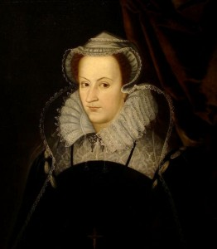
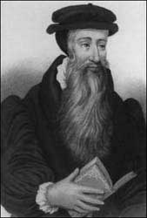
Mary, Queen of Scots: The royal lady was greatly moved upon by the Holy Spirit, but confused as to what to believe. “ You teach one thing,” she complained to Knox, “ and the church of Rome teaches another. Which shall I Believe? “
John Knox: answered “ You shall believe neither, madam: you shall believe God who speak in His Word. And save as we agree thereto, you shall believe nether of us.”
Mary, Queen of Scotland
John Knox, the founder of Presbyterianism

Slide 5
What The Lord Wants
MICAH 6:8
O people, the Lord has told you what is good, and this is what he requires of you: to do what is right, to love mercy, and to walk humbly with your God.

Slide 6
The Lord Requirements
Do Justly
Love Mercy
Walk Humbly

Slide 7
Triple Commands
DO JUSTLY
LOVE MERCY
WALK HUMBLY
Be Honestly
-Toward God.
-Toward Your Neighbors.
-Toward Ourselves.
More Pleasing to the Lord.
Proverbs 21: 2-3
The True Christians.
Philippians 1:6
Forgiveness
-Toward God.
-Toward Your Neighbors.
-Toward Ourselves.
Love All People.
Kindness
Compassion
You must show mercy.
James 2:13
Submission
-Toward God.
-Toward Your Neighbors.
-Toward Ourselves.
Give Your Lives to God.
Romans 12:1-2
Obedience to God.
1 John 2:3-4
Your Faith Depend on
God’s Love and Grace.

