Slide 1
What Christmas means
For unto you is born this day in the city of David a Saviour, which is Christ the Lord.
Luke 2:11
December 2, 2012
Rev. David B. Hanson
Deaf Liberty Baptist Church
Overland Park, Kansas

Slide 2
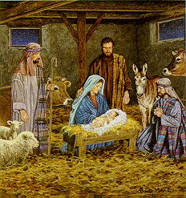
The Shepherds at the Nativity
Luke 2:8-20

Slide 3
Luke 2:8-20
8 And there were in the same country shepherds abiding in the field, keeping watch over their flock by night.
9 And, lo, the angel of the Lord came upon them, and the glory of the Lord shone round about them: and they were sore afraid.

Slide 4
Luke 2:8-20
10 And the angel said unto them, Fear not: for, behold, I bring you good tidings of great joy, which shall be to all people.
11 For unto you is born this day in the city of David a Saviour, which is Christ the Lord.
12 And this shall be a sign unto you; Ye shall find the babe wrapped in swaddling clothes, lying in a manger.

Slide 5
Luke 2:8-20
16 And they came with haste, and found Mary, and Joseph, and the babe lying in a manger.
17 And when they had seen it, they made known abroad the saying which was told them concerning this child.

Slide 6
Luke 2:8-20
20 And the shepherds returned, glorifying and praising God for all the things that they had heard and seen, as it was told unto them.

Slide 7
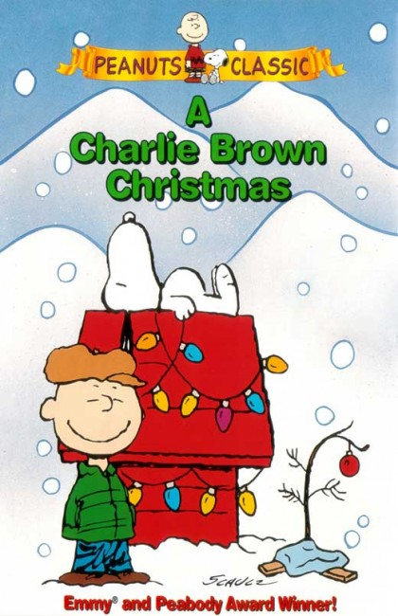
A Charlie Brown Christmas

Slide 8
A Charlie Brown Christmas
The half-hour special first aired (CBS) on Thursday, December 9th, 1965 at 7:30 P.M.
“Isn’t there anyone who knows what Christmas is all about?”

Slide 9
A Charlie Brown Christmas
A total of 50% of the televisions in the United States were tuned to the first broadcast.
A Charlie Brown Christmas won an Emmy and a Peabody award.
It today is considered to be one of the most beloved animated holiday specials of all time.

Slide 10
A Charlie Brown Christmas
A shoestring budget
A somewhat choppy animation style
The use of children to do much of the voice acting, instead of hiring adult actors
The absence of laugh track, a common element in children’s shows of that time

Slide 11
A Charlie Brown Christmas
Have Linus reciting the story of the birth of Jesus from the Gospel of Luke
Passages of the King James Version of the Bible
“If we don’t tell the true meaning of Christmas, who will?”

Slide 12
A Charlie Brown Christmas
Charlie Brown starts the seeking to understand why he always ends up depressed around the holidays
Lucy advises him to get involved in directing a school play about the Nativity

Slide 13
A Charlie Brown Christmas
He is given the lesser responsibility of finding a Christmas tree for the play
He chooses a pitiful little twig
Linus recites the story of the birth of Jesus

Slide 14
A Charlie Brown Christmas
His tree is fixed up into a brilliant Christmas display using the rest of Snoopy’s decorations
Charlie joins the crew in singing the Christmas carol "Hark! The Herald Angels Sing"

