Slide 1
Strangers in a strange land
Dearly beloved, I beseech you as strangers and pilgrims, abstain from fleshly lusts, which war against the soul;
I Peter 2:11
November 18, 2012
Rev. David B. Hanson
Deaf Liberty Baptist Church
Overland Park, Kansas

Slide 2
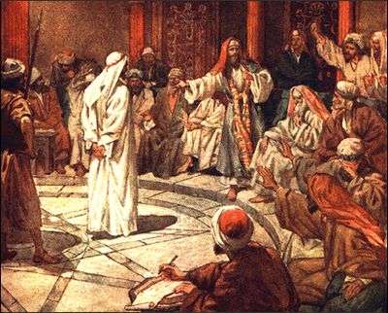
Jesus Stood Before the Governor

Slide 3
Matthew 27:11-12
11 And Jesus stood before the governor: and the governor asked him, saying, Art thou the King of the Jews? And Jesus said unto him, Thou sayest.
12 And when he was accused of the chief priests and elders, he answered nothing.

Slide 4
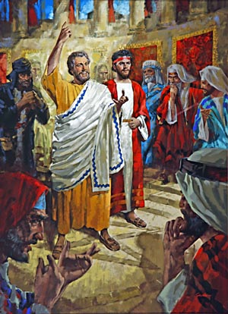
Peter & John Stood before the Council of 71 Men

Slide 5
Acts 4:5-7
5 And it came to pass on the morrow, that their rulers, and elders, and scribes,
6 And Annas the high priest, and Caiaphas, and John, and Alexander, and as many as were of the kindred of the high priest, were gathered together at Jerusalem.
7 And when they had set them in the midst, they asked, By what power, or by what name, have ye done this?

Slide 6
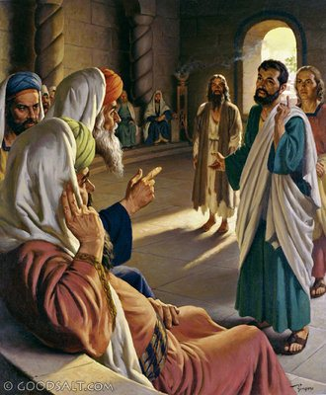
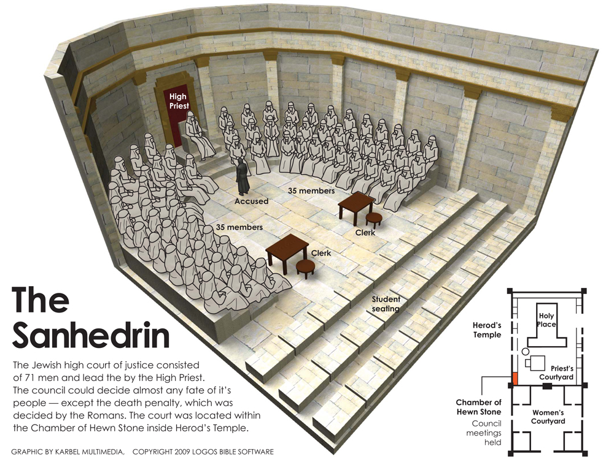
The Apostles Stood before the Council of 71 Men

Slide 7
Acts 5:25-27
25 Then came one and told them, saying, Behold, the men whom ye put in prison are standing in the temple, and teaching the people.
26 Then went the captain with the officers, and brought them without violence: for they feared the people, lest they should have been stoned.
27 And when they had brought them, they set them before the council: and the high priest asked them,

Slide 8
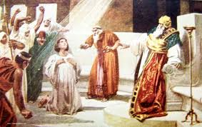
Stephen Stood before the Jews of the Synagogue

Slide 9
Acts 6:8-10
8 And Stephen, full of faith and power, did great wonders and miracles among the people.
9 Then there arose certain of the synagogue, which is called the synagogue of the Libertines, and Cyrenians, and Alexandrians, and of them of Cilicia and of Asia, disputing with Stephen.
10 And they were not able to resist the wisdom and the spirit by which he spake.

Slide 10
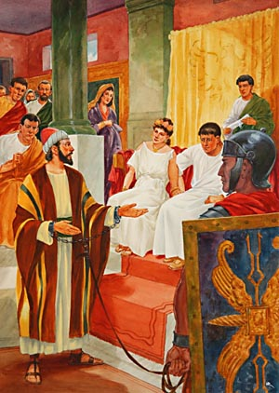
Paul Stood before Felix

Slide 11
Acts 25:9-10
9 But Festus, willing to do the Jews a pleasure, answered Paul, and said, Wilt thou go up to Jerusalem, and there be judged of these things before me?
10 Then said Paul, I stand at Caesar's judgment seat, where I ought to be judged: to the Jews have I done no wrong, as thou very well knowest.

Slide 12
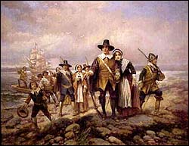
The Pilgrims

Slide 13
Why the Pilgrims Left England
A Puritan is a Christian who believed that the Church of England ought to institute strict reforms to eliminate all vestiges of Catholic practices
A Separatist is a Christian who believed that a congregation should be separated from the Church of England.
Two Leaders: William Brewster and William Bradford

