Slide 1
Jesus Christ our anchor
Which hope we have as an anchor of the soul, both sure and stedfast, and which entereth into that within the veil;
Hebrews 6:19
September 9, 2012
Rev. David B. Hanson
Deaf Liberty Baptist Church
Overland Park, Kansas

Slide 2
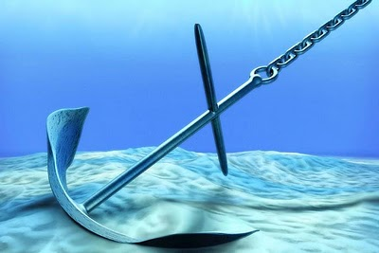
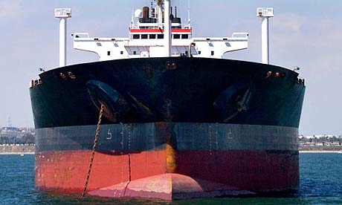
An Anchor of a Ship

Slide 3
Hebrews 6:16
For men verily swear by the greater: and an oath for confirmation is to them an end of all strife.

Slide 4
Hebrews 6:17
Wherein God, willing more abundantly to shew unto the heirs of promise the immutability of his counsel, confirmed it by an oath:

Slide 5
Hebrews 6:18
That by two immutable things, in which it was impossible for God to lie, we might have a strong consolation, who have fled for refuge to lay hold upon the hope set before us:

Slide 6
Hebrews 6:19
Which hope we have as an anchor of the soul, both sure and stedfast, and which entereth into that within the veil;

Slide 7
Hebrews 6:20
Whither the forerunner is for us entered, even Jesus, made an high priest for ever after the order of Melchisedec.

Slide 8
Two Immutable Things
God’s Promise
God’s Oath
Jesus Christ Our Anchor of Our Souls
Jesus Christ Our Forerunner

Slide 9
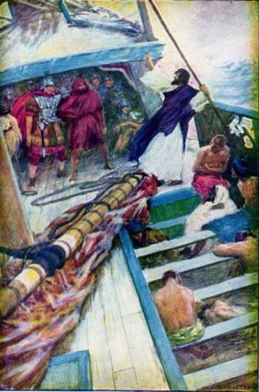
Acts 27:1-44 Paul’s Ship During the Storm

Slide 10
Four Anchors of Paul’s Ship
Acts 27:29
Then fearing lest we should have fallen upon rocks, they cast four anchors out of the stern, and wished for the day.

Slide 11
The Strong Anchor of God’s Presence
Acts 27:23
For there stood by me this night the angel of God, whose I am, and whom I serve,

Slide 12
The Strong Anchor of God’s Plan
Acts 27:24
Saying, Fear not, Paul; thou must be brought before Caesar: and, lo, God hath given thee all them that sail with thee.

Slide 13
The Strong Anchor of God’s Promises
Acts 27:25
Wherefore, sirs, be of good cheer: for I believe God, that it shall be even as it was told me.

Slide 14
The Strong Anchor of God’s Power
Acts 27:44
And the rest, some on boards, and some on broken pieces of the ship. And so it came to pass, that they escaped all safe to land.

