Slide 1
Prayer Asking and receiving
Ask, and it shall be given you; seek, and ye shall find; knock, and it shall be opened unto you:
Matthew 7:7
August 12, 2012
Rev. David B. Hanson
Deaf Liberty Baptist Church
Overland Park, Kansas

Slide 2
Matthew 7:7-8
7 Ask, and it shall be given you; seek, and ye shall find; knock, and it shall be opened unto you:
8 For every one that asketh receiveth; and he that seeketh findeth; and to him that knocketh it shall be opened.

Slide 3
Three-Fold Encouragement: To Pray
1. Ask
2. Seek
3. Knock

Slide 4
Ask
1. to ask for with urgency
2. to make a humble, earnest plea
3. to call on for an answer
4. to expect Him to answer
5. to keep on asking
Pray as a beggar does

Slide 5
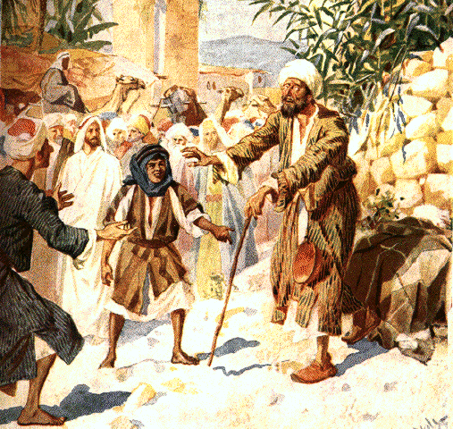
Blind Bartimaeus

Slide 6
Blind Bartimaeus
Mark 10:46-47
46 And they came to Jericho: and as he went out of Jericho with his disciples and a great number of people, blind Bartimaeus, the son of Timaeus, sat by the highway side begging.

Slide 7
Blind Bartimaeus
Mark 10:46-47
47 And when he heard that it was Jesus of Nazareth, he began to cry out, and say, Jesus, thou son of David, have mercy on me.

Slide 8
Blind Bartimaeus
Mark 10:51-52
51 And Jesus answered and said unto him, What wilt thou that I should do unto thee? The blind man said unto him, Lord, that I might receive my sight.

Slide 9
Blind Bartimaeus
Mark 10:51-52
52 And Jesus said unto him, Go thy way; thy faith hath made thee whole. And immediately he received his sight, and followed Jesus in the way.

Slide 10
Seek
1. to attempt to learn something by careful searching
2. to desire to have something
3. to pray with an active endeavoring to fulfill needs
Pray as a seeker for a lost thing

Slide 11
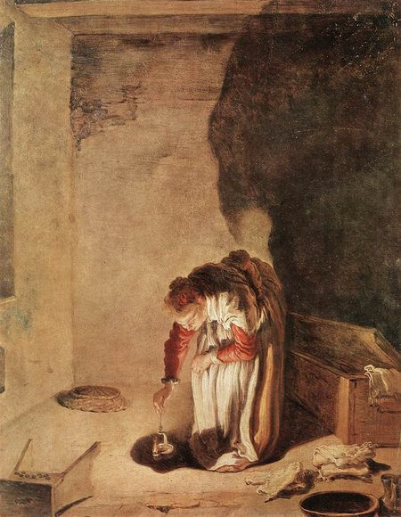
A Woman Seeks for a Lost Coin

Slide 12
A Woman Seeks for a Lost Coin
Luke 15:8-9
8 Either what woman having ten pieces of silver, if she lose one piece, doth not light a candle, and sweep the house, and seek diligently till she find it?

Slide 13
A Woman Seeks for a Lost Coin
Luke 15:8-9
9 And when she hath found it, she calleth her friends and her neighbours together, saying, Rejoice with me; for I have found the piece which I had lost.

Slide 14
Knock
1. to knock a door with hard knocks for entrance
2. to knock and knock and keep on knocking
3. to continue praying in the face of difficulty and even resistance
Pray as a person keeps knocking a door

Slide 15
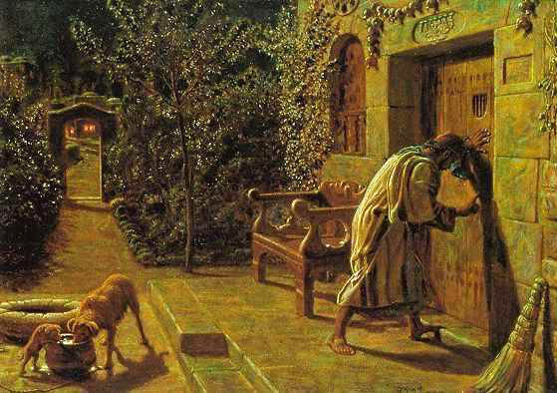
A Friend Knocks a Door

Slide 16
A Friend Knocks a Door
Luke 11:5-6
5 And he said unto them, Which of you shall have a friend, and shall go unto him at midnight, and say unto him, Friend, lend me three loaves;

Slide 17
A Friend Knocks a Door
Luke 11:5-6
6 For a friend of mine in his journey is come to me, and I have nothing to set before him?

Slide 18
A Friend Knocks a Door
Luke 11:7-8
7 And he from within shall answer and say, Trouble me not: the door is now shut, and my children are with me in bed; I cannot rise and give thee.

Slide 19
A Friend Knocks a Door
Luke 11:7-8
8 I say unto you, Though he will not rise and give him, because he is his friend, yet because of his importunity he will rise and give him as many as he needeth.

Slide 20
A Railroad Engineer
A husband was a sinful man.
His wife was praying for him for 27 years.
God promised her that he should be saved.
He died at the hospital, and 7 doctors confirmed that he died.
His wife kneeled beside his cot praying for 13 hours.
He opened his eyes and then became a Christian.

