Slide 1
ANGER
Sunday, August 4, 2012
Deaf Liberty Baptist Church
Bro. Clark H. Corogenes

Slide 2
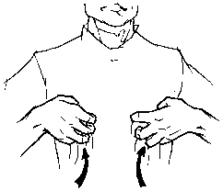
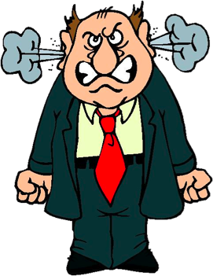
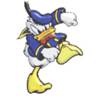

Slide 3
The Biblical Perspective of ANGER
Anger is a state of disturbing and energizing passion in which strong negative emotion is triggered by a perception of wrong done to oneself or others or both.
Capacity for anger, like that for joy and grief, is ours as moral and relational beings made in God’s image.
So God created human beings in his image. In the image of God he created them. He created them male and female. Genesis 1:27
Bibliography
Alexander Desmond and Rosner Brian. New Dictionary of Biblical Theology. Inter-Varsity Press, 2000
“ I believe that the human capacity for anger is rooted in the nature of God.”
Dr. Gary Chapmen

Slide 4
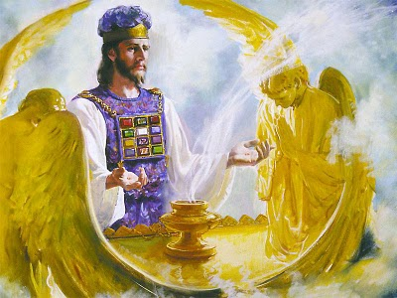
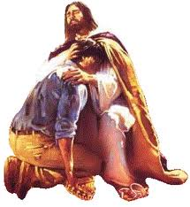
What about Jesus Christ ?
For we do not have a high priest who is unable to empathize with our weaknesses, but we have one who has been tempted in every way, just as we are —yet he did not sin.
Hebrews 4:15

Slide 5
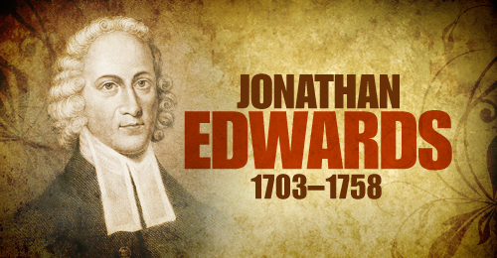
The Anger of God
God’s Characters
Wrath
God judgeth the righteous, and God is angry with the wicked every day.
Psalm 7:11
Whoever believes in the Son has eternal life, but whoever rejects the Son will not see life, for God’s wrath remains on them.
John 3:36
Notes:
Jonathan Edwards wrote book of “Sinners in the Hands of an Angry God.” He was a president of Princeton University. Two Deaf of Buchhloz

Slide 6
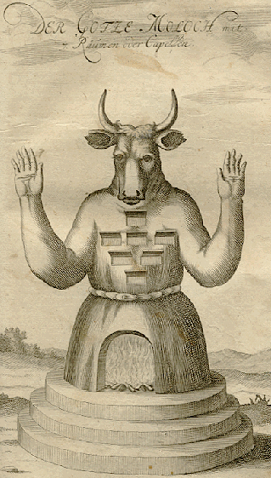
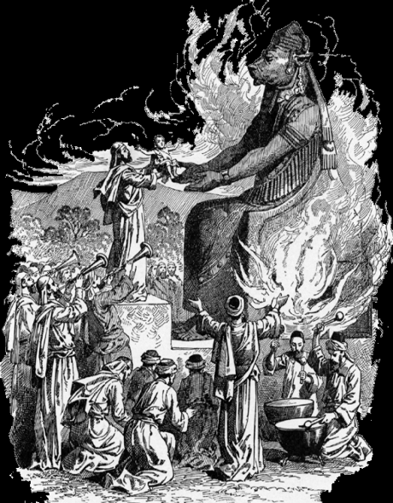
The Anger of God
God’s Characters
Wrath
They sacrificed their sons and daughters in the fire. They practiced divination and sought omens and sold themselves to do evil in the eyes of the Lord, arousing his anger. So the Lord was very angry with Israel and removed them from his presence. Only the tribe of Judah was left,
2 Kings 17: 17-18
Notes:
Wicked Israel King name: Jeroboam and Assyria Empire will control.

Slide 7
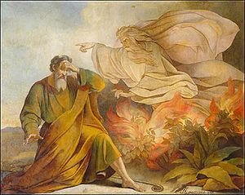
The Anger of God
God’s Characters
Slow to anger
And he passed in front of Moses, proclaiming, “The Lord, the Lord, the compassionate and gracious God, slow to anger, abounding in love and faithfulness,
Exodus 34:6
Notes:
Moses met God at the Mount Sinai.

Slide 8
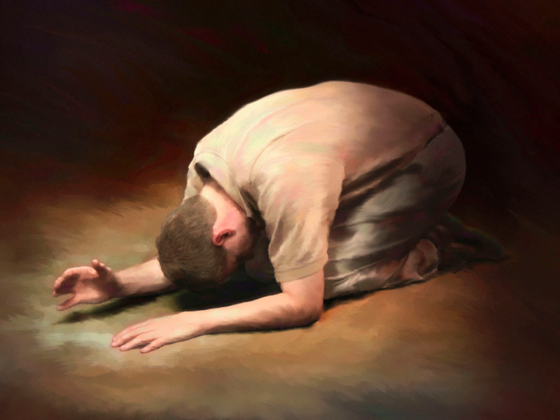
The Anger of God
God’ Characters
Faithfulness
If we confess our sins, he is faithful and just and will forgive us our sins and purify us from all unrighteousness.
1 John 1:9
Notes:
God never failure or forsaking or rejecting or hate

Slide 9
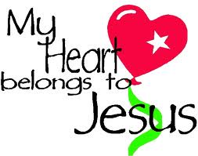
The Anger of God
God’s Characters
Holiness and Love
Dear friends, let us love one another, for love comes from God. Everyone who loves has been born of God and knows God. Whoever does not love does not know God, because God is love. This is how God showed his love among us: He sent his one and only Son into the world that we might live through him.
1 John 4: 7-9

Slide 10
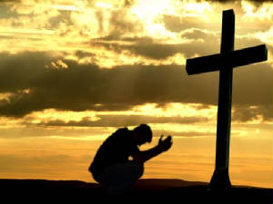
How to handle with Angry ?
The Fruit of Spirit: Self-Control.
Galatians 5:22-23
Quick to Listen, Slow to Speak, and Slow to Anger.
James 1:18-21
Do not let anger to become a bitterly or hateful or hurtful.
Ephesians 4: 25-27

