Slide 1
Champions for Christ
I press toward the mark for the prize of the high calling of God in Christ Jesus.
Philippians 3:14
July 22, 2012
Rev. David B. Hanson
Deaf Liberty Baptist Church
Overland Park, Kansas

Slide 2
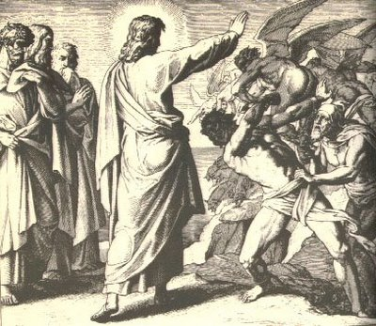
A Man With the Legion

Slide 3
A Man With the Legion
Mark 5:18
And when he was come into the ship, he that had been possessed with the devil prayed him that he might be with him.

Slide 4
A Man With the Legion
Mark 5:19
Howbeit Jesus suffered him not, but saith unto him, Go home to thy friends, and tell them how great things the Lord hath done for thee, and hath had compassion on thee.

Slide 5
A Man With the Legion
Mark 5:20
And he departed, and began to publish in Decapolis how great things Jesus had done for him: and all men did marvel.

Slide 6
A Man With the Legion
A man was possessed with the devil.
He was well-known among the people.
He was healed by Jesus.
He became a champion for Christ by telling the people what great things Jesus had done for him.

Slide 7
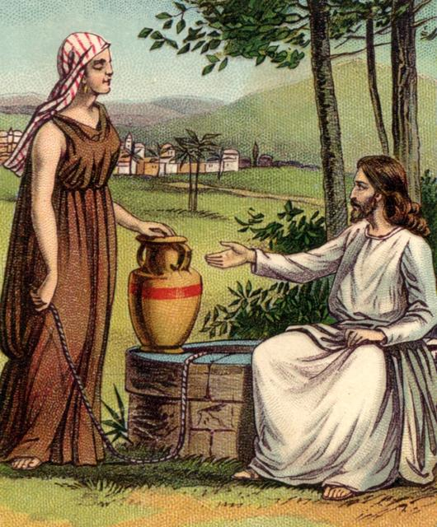
A Samaritan Woman At Jacob’s Well

Slide 8
A Samaritan Woman At Jacob’s Well
John 4:28
The woman then left her waterpot, and went her way into the city, and saith to the men,

Slide 9
A Samaritan Woman At Jacob’s Well
John 4:29
Come, see a man, which told me all things that ever I did: is not this the Christ?

Slide 10
A Samaritan Woman At Jacob’s Well
John 4:30
Then they went out of the city, and came unto him.

Slide 11
A Samaritan Woman At Jacob’s Well
John 4:39
And many of the Samaritans of that city believed on him for the saying of the woman, which testified, He told me all that ever I did.

Slide 12
A Samaritan Woman At Jacob’s Well
John 4:40
So when the Samaritans were come unto him, they besought him that he would tarry with them: and he abode there two days.

Slide 13
A Samaritan Woman At Jacob’s Well
John 4:41
And many more believed because of his own word;

Slide 14
A Samaritan Woman At Jacob’s Well
John 4:42
And said unto the woman, Now we believe, not because of thy saying: for we have heard him ourselves, and know that this is indeed the Christ, the Saviour of the world.

Slide 15
A Samaritan Woman At Jacob’s Well
A Samaritan woman believed in God but did not know that Jesus was Messiah who was called Christ.
She realized that she met Him at the well.
She became a champion for Christ by going to tell her friends that she met Him.

Slide 16
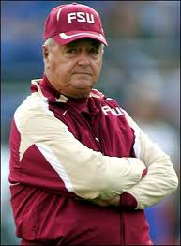
Coach Bobby Bowden

Slide 17
Coach Bobby Bowden
College football coach for Florida State University Seminoles from 1976 to 2009
National Champions in 1993 and 1999
Career second in all-time wins 377–129–4

Slide 18
Coach Bobby Bowden
Bobby’s rededication of his life to Jesus Christ
"When I recommitted my life, my whole thinking was...God I'm making myself available to You. I think You've led me into coaching. I think this is what You want me to do, God.”

Slide 19
Coach Bobby Bowden
Unashamedly, Coach Bowden used football at the stadium as a pulpit to witness to young men for the last 53 years.

Slide 20
Coach Bobby Bowden
Coach Bowden gave second chances to players who broke team rules.
Coach Bowden said that God extended grace to him and when given the opportunity, he'll do the same.

Slide 21
Coach Bobby Bowden
"When I put everything in God's hands, I don't have to worry about anything. I don't have to worry about winning ballgames," Bowden proclamed. "I want to win as much as anybody does, but I don't have to worry about this. I know that when I die, I live eternally with my God, so the pressure's off."

