Slide 1
Preserve Life and Prevent Decay
Ye are the salt of the earth: but if the salt have lost his savour, wherewith shall it be salted? it is thenceforth good for nothing, but to be cast out, and to be trodden under foot of men.
Matthew 5:13
May 27, 2012
Rev. David B. Hanson
Deaf Liberty Baptist Church
Overland Park, Kansas

Slide 2
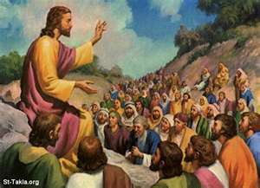
The Salt of the Earth

Slide 3
The Important Role of Salt
Salt is necessary for the human body to function.
Treaties are ratified by the exchange of salt.
Salt is valuable for trade and commerce.
Salt is an important source of tax revenue.

Slide 4
The Important Role of Salt
Salt is used as a freezer or refrigerator to preserve food as meats, vegetables and fruits.
Salt acts as a fertilizer to make acidic land to be productive.
Salt is a gift for the gods as people praise their god or gods.
Salt symbolizes the endurance and faithfulness.

Slide 5
Christians Are the Salt of the Earth
1. Christians are the followers of Jesus Christ.
2. Christians prevent decay and destruction and rottenness.
3. Christians preserve life.
4. Christians promote growth.
5. Christians are the salt of humanity.

Slide 6
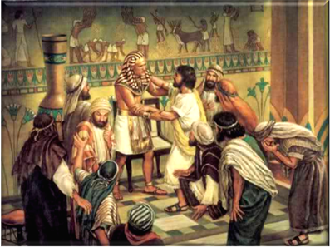
Joseph in Egypt

Slide 7
Joseph in Egypt
Genesis 41:46
And Joseph was thirty years old when he stood before Pharaoh king of Egypt. And Joseph went out from the presence of Pharaoh, and went throughout all the land of Egypt.
Joseph is the salt of Egypt.

Slide 8
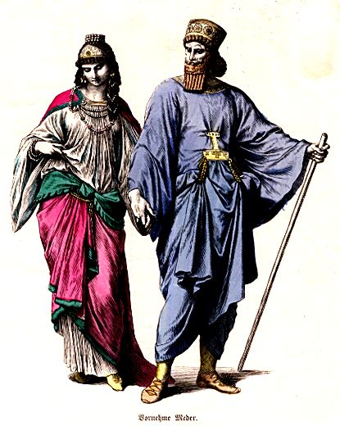
Esther in Persia

Slide 9
Esther in Persia
Esther 2:17
And the king loved Esther above all the women, and she obtained grace and favour in his sight more than all the virgins; so that he set the royal crown upon her head, and made her queen instead of Vashti.
Esther is the salt of the Jews in Persia.

Slide 10
Live as the Salt of the Earth
We prevent destruction and decay.
We preserve life.
We resist sin, evil, and wickedness.
We fight against wickedness and darkness.

Slide 11
Live as the Salt of the Earth
We promote life and growth.
We engage in missions, evangelism, and witnessing.
We have prayers of intercession for the world.

Slide 12
Do Not Resist Our Saltiness
Jesus gives us a warning about salt losing its saltiness.
Salt is obtained from evaporated pools by the shore of the Dead or Salt Sea.
Salt crust, dug up from the surface of the soil, is never pure, but contains impurities.

Slide 13
Do Not Resist Our Saltiness
Jesus gives us a warning about salt losing its saltiness.
Salt is obtained from evaporated water.
Salt crust contains impurities.

Slide 14
Do Not Resist Our Saltiness
Do not lose your vision of the Great Commission.
Do not think and act like the non-Christians.

Slide 15
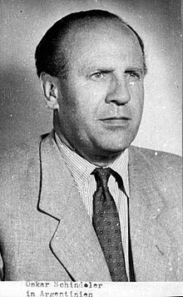
Oscar Schindler

Slide 16
Oscar Schindler
Oscar Schindler was born in Moravia on April 28, 1908.
He was a German industrialist.
He rescued about 1,200 Polish Jews from being murdered by Hitler.
He died penniless on October 9, 1974.

