Slide 1
Jesus Christ Our Provider
But my God shall supply all your need according to his riches in glory by Christ Jesus. Philippians 4:19
March 25, 2012
Rev. David B. Hanson
Deaf Liberty Baptist Church
Overland Park, Kansas

Slide 2
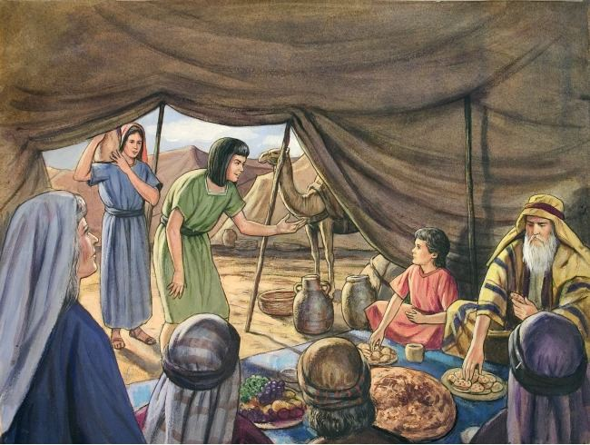

Slide 3
God Protects Us in Our Times of Trouble
Genesis 21:8-10
⁸And the child grew, and was weaned: and Abraham made a great feast the same day that Isaac was weaned.
⁹And Sarah saw the son of Hagar the Egyptian, which she had born unto Abraham, mocking.

Slide 4
God Protects Us in Our Times of Trouble
Genesis 21:8-10
¹⁰Wherefore she said unto Abraham, Cast out this bondwoman and her son: for the son of this bondwoman shall not be heir with my son, even with Isaac.

Slide 5
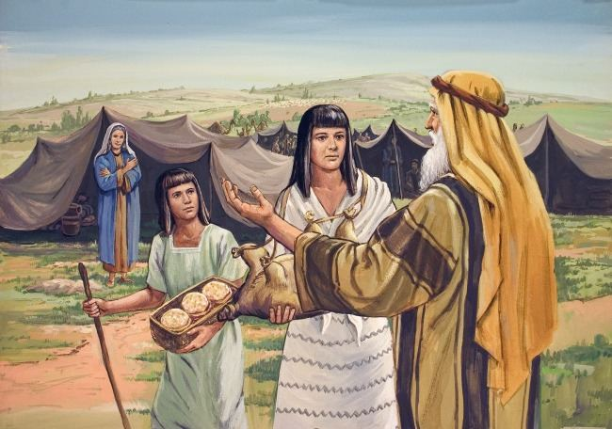

Slide 6
God Promises Us in Our Times of Doubt
Genesis 21:11-14
¹¹And the thing was very grievous in Abraham's sight because of his son.
¹²And God said unto Abraham, Let it not be grievous in thy sight because of the lad, and because of thy bondwoman; in all that Sarah hath said unto thee, hearken unto her voice; for in Isaac shall thy seed be called.

Slide 7
God Promises Us in Our Times of Doubt
Genesis 21:11-14
¹³And also of the son of the bondwoman will I make a nation, because he is thy seed.
¹⁴And Abraham rose up early in the morning, and took bread, and a bottle of water, and gave it unto Hagar, putting it on her shoulder, and the child, and sent her away: and she departed, and wandered in the wilderness of Beersheba.

Slide 8
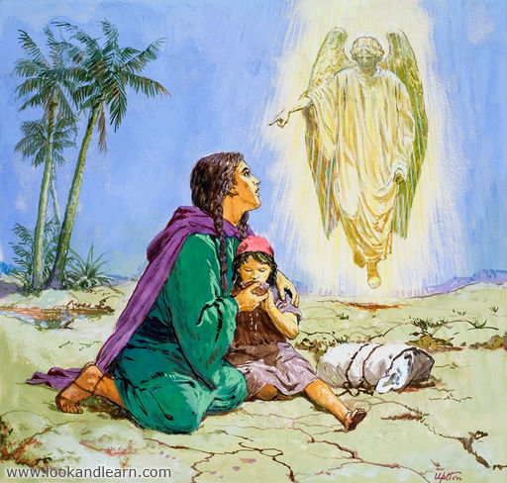

Slide 9
God Hears Us in Our Times of Distress
Genesis 21:15-18
¹⁵And the water was spent in the bottle, and she cast the child under one of the shrubs.
¹⁶And she went, and sat her down over against him a good way off, as it were a bow shot: for she said, Let me not see the death of the child. And she sat over against him, and lift up her voice, and wept.

Slide 10
God Hears Us in Our Times of Distress
Genesis 21:15-18
¹⁷And God heard the voice of the lad; and the angel of God called to Hagar out of heaven, and said unto her, What aileth thee, Hagar? fear not; for God hath heard the voice of the lad where he is.
¹⁸Arise, lift up the lad, and hold him in thine hand; for I will make him a great nation.

Slide 11
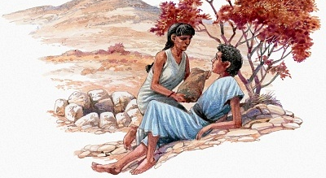

Slide 12
God Provides for Us in Our Times of Need
Genesis 21:19-21
¹⁹And God opened her eyes, and she saw a well of water; and she went, and filled the bottle with water, and gave the lad drink.

Slide 13
God Provides for Us in Our Times of Need
Genesis 21:19-21
²⁰And God was with the lad; and he grew, and dwelt in the wilderness, and became an archer.
²¹And he dwelt in the wilderness of Paran: and his mother took him a wife out of the land of Egypt.

