Slide 1
THE MACEDONIAN CALL
And a vision appeared to Paul in the night; There stood a man of Macedonia, and prayed him, saying, Come over into Macedonia, and help us.
Acts 16:9
March 11, 2012
Rev. David B. Hanson
Deaf Liberty Baptist Church
Overland Park, Kansas

Slide 2
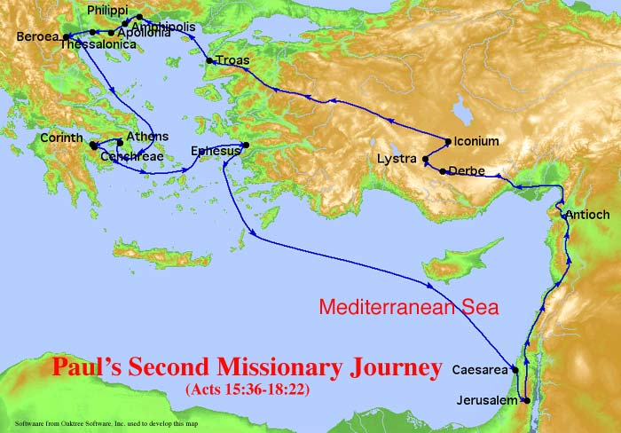
Paul’s Second Missionary Journey

Slide 3
Paul Starts His Second Journey
Acts 16:6-7
⁶Now when they had gone throughout Phrygia and the region of Galatia, and were forbidden of the Holy Ghost to preach the word in Asia,
⁷After they were come to Mysia, they assayed to go into Bithynia: but the Spirit suffered them not.

Slide 4
Paul's Plan Is Blocked
Paul goes to strengthen the churches
Paul selects Silas
Timothy joins Paul and Silas in Lystra
Paul tries to go to Ephesus and Bithynia
Paul goes to Troas

Slide 5
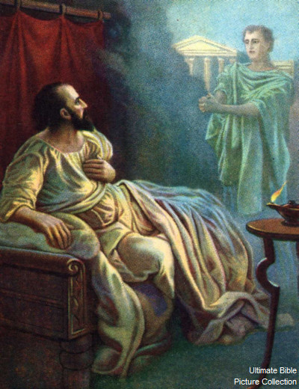
Paul’s Vision

Slide 6
Paul Has a Vision
Acts 16:9-10
⁹And a vision appeared to Paul in the night; There stood a man of Macedonia, and prayed him, saying, Come over into Macedonia, and help us.
¹⁰And after he had seen the vision, immediately we endeavoured to go into Macedonia, assuredly gathering that the Lord had called us for to preach the gospel unto them.

Slide 7
God Directs Paul In a New Direction
God reveals a vision to Paul
A man of Macedonia needs help
Paul obeys to preach the gospel in Macedonia
Luke joins Paul

Slide 8
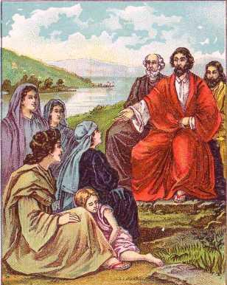
Lydia at Philippi

Slide 9
Lydia Is Converted
Acts 16:14-15
¹⁴And a certain woman named Lydia, a seller of purple, of the city of Thyatira, which worshipped God, heard us: whose heart the Lord opened, that she attended unto the things which were spoken of Paul.
¹⁵And when she was baptized, and her household, she besought us, saying, If ye have judged me to be faithful to the Lord, come into my house, and abide there. And she constrained us.

Slide 10
Lydia’s Heart Is Opened
Lydia is a seller of purple cloth
Lydia is a worshiper of God
Paul speaks the Gospel to Lydia
God opens Lydia’s heart
Lydia wants Paul to stay at her house so she learns more about Jesus Christ

Slide 11
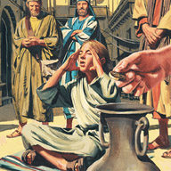
A Young Woman with a Spirit of Divination

Slide 12
Paul Commands a Demon to Come Out of a Young Woman
Acts 16:16-18
¹⁶And it came to pass, as we went to prayer, a certain damsel possessed with a spirit of divination met us, which brought her masters much gain by soothsaying:
¹⁷The same followed Paul and us, and cried, saying, These men are the servants of the most high God, which shew unto us the way of salvation.
¹⁸And this did she many days. But Paul, being grieved, turned and said to the spirit, I command thee in the name of Jesus Christ to come out of her. And he came out the same hour.

Slide 13
God’s Power Is Revealed
A young woman has a spirit of divination
A young woman makes large profit for her masters by soothing
A young woman bothers Paul for many days
Paul is grieved
Paul exorcises a demon out of a young woman
A young woman’s masters lose large profit

Slide 14
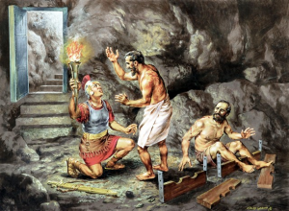
The Keeper of the Prison at Philippi

Slide 15
The Jailor Is Converted
Acts 16:29-31
²⁹Then he called for a light, and sprang in, and came trembling, and fell down before Paul and Silas,
³⁰And brought them out, and said, Sirs, what must I do to be saved?
³¹And they said, Believe on the Lord Jesus Christ, and thou shalt be saved, and thy house.

Slide 16
The Jailor Asks for Salvation
Paul and Silas are put in the prison because of their anti-Roman customs
Paul and Silas pray and sing praises to God
The great earthquake opens all the doors of the prison
The jailor awakes and tries to kill himself
The jailor asks Paul and Silas about how to be saved
Paul shows the jailor the way of salvation

