Slide 1
FEEDING THE 4,000
And they that had eaten were about four thousand: and he sent them away.
Mark 8:9
January 29, 2012
Rev. David B. Hanson
Deaf Liberty Baptist Church
Overland Park, Kansas

Slide 2
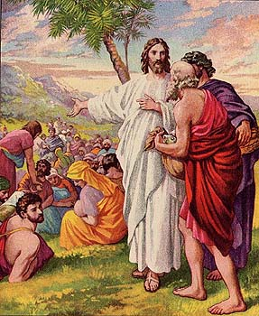
FEEDING THE 4,000

Slide 3
THE COMPASSIONATE CHRIST
Mark 8:1-3
¹In those days the multitude being very great, and having nothing to eat, Jesus called his disciples unto him, and saith unto them,
²I have compassion on the multitude, because they have now been with me three days, and have nothing to eat:
³And if I send them away fasting to their own houses, they will faint by the way: for divers of them came from far.

Slide 4
THE PERPLEXITY OF THE DISCIPLES
Mark 8:4
⁴And his disciples answered him, From whence can a man satisfy these men with bread here in the wilderness?

Slide 5
THE PERFORMANCE OF A MIRACLE
Mark 8:5-7
⁵And he asked them, How many loaves have ye? And they said, Seven.
⁶And he commanded the people to sit down on the ground: and he took the seven loaves, and gave thanks, and brake, and gave to his disciples to set before them; and they did set them before the people.
⁷And they had a few small fishes: and he blessed, and commanded to set them also before them.

Slide 6
Comparison of Feeding the 5,000 and the 4,000
MARK 6:34-44
Mark 8:1-9
Feeding of the 5,000
One Day
Mostly Jews
Bethsaida on the northeastern shore of the Sea of Galilee
5 loaves and 2 fish
12 small baskets of leftovers
Feeding of the 4,000
Three Days
Mostly Gentiles
Decapolis on the southeastern shore of the Sea of Galilee
7 loaves and a few small fish
7 large baskets of leftovers

Slide 7
The Abundance for Life
Mark 8:8-9
⁸So they did eat, and were filled: and they took up of the broken meat that was left seven baskets.
⁹And they that had eaten were about four thousand: and he sent them away.

Slide 8
Abundant Life in Jesus Christ
John 10:10-11
¹⁰The thief cometh not, but for to steal, and to kill, and to destroy: I am come that they might have life, and that they might have it more abundantly.
¹¹I am the good shepherd: the good shepherd giveth his life for the sheep.

