Slide 1
Draw nigh to God
Draw nigh to God, and he will draw nigh to you. Cleanse your hands, ye sinners; and purify your hearts, ye double minded.
James 4:8
January 8, 2012
Rev. David B. Hanson
Deaf Liberty Baptist Church
Overland Park, Kansas

Slide 2
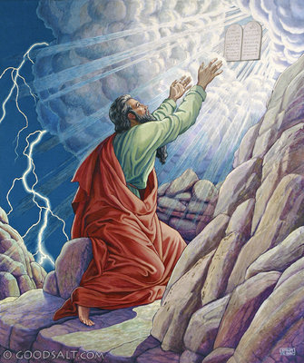
Exodus 24 Moses was in the mount for 40 days and 40 nights

Slide 3
Moses went up into the mount
Exodus 24:15-18
¹⁵And Moses went up into the mount, and a cloud covered the mount.
¹⁶And the glory of the LORD abode upon mount Sinai, and the cloud covered it six days: and the seventh day he called unto Moses out of the midst of the cloud.

Slide 4
Moses was in the mount for forty days
Exodus 24:15-18
¹⁷And the sight of the glory of the LORD was like devouring fire on the top of the mount in the eyes of the children of Israel.
¹⁸And Moses went into the midst of the cloud, and gat him up into the mount: and Moses was in the mount forty days and forty nights.

Slide 5
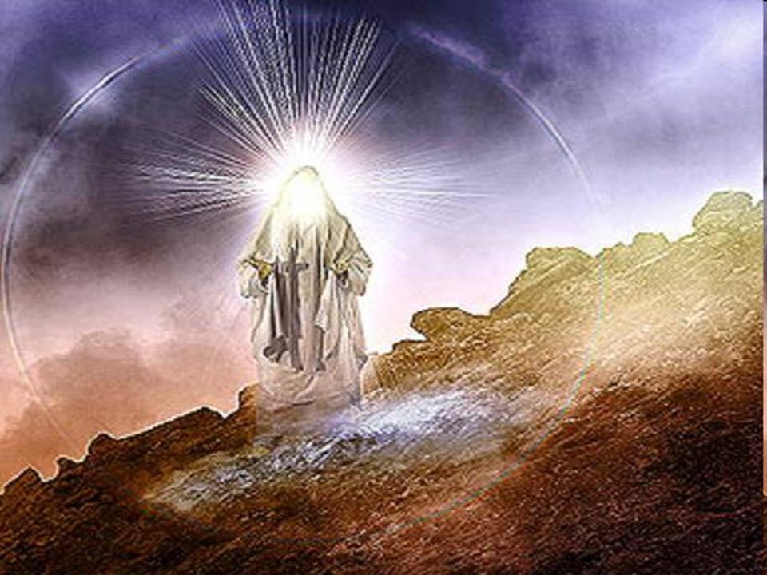
Exodus 34 Moses’ face shone

Slide 6
Moses’ face shone
Exodus 34:28-29, 35
²⁸And he was there with the LORD forty days and forty nights; he did neither eat bread, nor drink water. And he wrote upon the tables the words of the covenant, the ten commandments.

Slide 7
Moses’ face shone
Exodus 34:28-29, 35
²⁹And it came to pass, when Moses came down from mount Sinai with the two tables of testimony in Moses' hand, when he came down from the mount, that Moses wist not that the skin of his face shone while he talked with him.

Slide 8
Moses put the vail upon his face
Exodus 34:28-29, 35
³⁵And the children of Israel saw the face of Moses, that the skin of Moses' face shone: and Moses put the vail upon his face again, until he went in to speak with him.

Slide 9
Jesus draws any person
John 6:44
No man can come to me, except the Father which hath sent me draw him: and I will raise him up at the last day.
The word “helco” for the word “draw” is “to induce to come.”
You decide - “I will draw near to God. I will seek God until I find Him.”

Slide 10
How to draw nigh to God
James 4:8
Draw nigh to God, and he will draw nigh to you. Cleanse your hands, ye sinners; and purify your hearts, ye double minded.
1. Cleanse your hands
Clean out your evil ways
2. Purify your hearts
Clear your minds

Slide 11
How to draw nigh to God
Hebrews 10:22
Let us draw near with a true heart in full assurance of faith, having our hearts sprinkled from an evil conscience, and our bodies washed with pure water.
1. Have a true heart
2. Have a clear conscience
3. Have a clean heart

