Slide 1
Hark! The Herald Angels Sing
¹³And suddenly there was with the angel a multitude of the heavenly host praising God, and saying,
¹⁴Glory to God in the highest, and on earth peace, good will toward men.
Luke 2:13-14
December 11, 2011
Rev. David B. Hanson
Deaf Liberty Baptist Church
Overland Park, Kansas

Slide 2
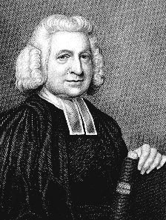
Charles Wesley the writer

Slide 3
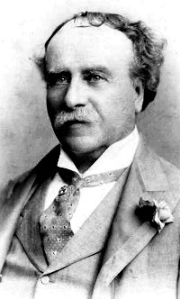
Felix Mendelssohn The song composer

Slide 4
The origin of “Hark! The herald angels sing”
Charles Wesley wrote, “Hark! The Herald Angels Sing” in the collection Hymns and Sacred Poems in 1739.
The tune for this classic song was written by Felix Mendelssohn in 1840.
“Hark!”
This word means PAY ATTENTION, or LISTEN!
“Hail!”
The word “Hail!” means to acclaim, salute, acknowledge.

Slide 5
The birth announcement
“Hark! The herald angels sing, Glory to the newborn King; Peace on earth, and mercy mild, God and sinners reconciled. Joyful all Ye Nations rise. Join the triumph of the skies. With angelic hosts proclaim, Christ is born in Bethlehem. Hark! The herald angels sing, Glory to the newborn King.”

Slide 6
The Birth announcement
Angels
The angels are the messengers.
Hebrews 13:2
Be not forgetful to entertain strangers: for thereby some have entertained angels unawares.
Shepherds
The shepherds are the ordinary, average, everyday people.
Acts 10:34
Then Peter opened his mouth, and said, Of a truth I perceive that God is no respecter of persons:

Slide 7
Who Jesus was
“Christ by highest heaven adored; Christ, the everlasting Lord! Late in time behold Him come, Offspring of the virgin’s womb: Veiled in flesh the Godhead see, Hail, the incarnate deity. Pleased as man with men to dwell, Jesus our Emmanuel. Hark! The herald angels sing, Glory to the newborn King.”

Slide 8
Who Jesus was
His DEITY
John 1:1
In the beginning was the Word, and the Word was with God, and the Word was God.
His VIRGIN BIRTH
Isaiah 7:14
Therefore the Lord himself shall give you a sign; Behold, a virgin shall conceive, and bear a son, and shall call his name Immanuel.

Slide 9
Who Jesus was
His INCARNATION
John 1:14
And the Word was made flesh, and dwelt among us, (and we beheld his glory, the glory as of the only begotten of the Father,) full of grace and truth.
His HUMANITY
Hebrews 4:15
For we have not an high priest which cannot be touched with the feeling of our infirmities; but was in all points tempted like as we are, yet without sin.

Slide 10
WHAT JESUS OFFERS
“Hail the heaven born prince of peace! Hail the Sun of Righteousness! Light and life to all He brings, Risen with healing in His wings. Mild he lays his Glory by, born that man no more may die. Born to raise the sons of earth. Born to give them second birth. Hark! The herald angels sing, Glory to the newborn King.”

Slide 11
WHAT JESUS OFFERS
Jesus brings LIGHT and LIFE
John 1:4
In him was life; and the life was the light of men.
Jesus brings HEALING
I Peter 2:24
Who his own self bare our sins in his own body on the tree, that we, being dead to sins, should live unto righteousness: by whose stripes ye were healed.
Jesus brings VICTORY OVER DEATH
I Corinthians 15:54
So when this corruptible shall have put on incorruption, and this mortal shall have put on immortality, then shall be brought to pass the saying that is written, Death is swallowed up in victory.

