Slide 1
What Will Happen if God’s Word Is Forgotten?
My people are destroyed for lack of knowledge: because thou hast rejected knowledge, I will also reject thee, that thou shalt be no priest to me: seeing thou hast forgotten the law of thy God, I will also forget thy children.
Hosea 4:6
September 11, 2011
Rev. David B. Hanson
Deaf Liberty Baptist Church
Overland Park, Kansas

Slide 2
The Jews Rejected God’s Word Because…”
Many Jews during Hosea’s time refused:
To listen God’s Word
To read God’s Word
To obey God’s Word

Slide 3
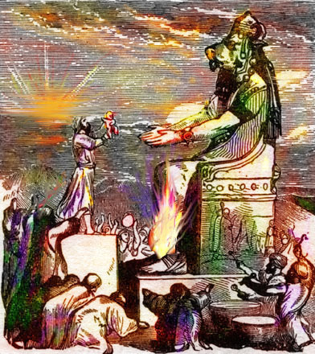
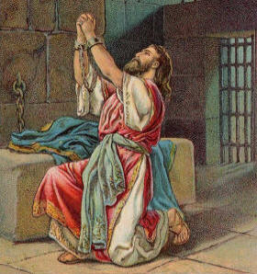
King Manasseh, King Josiah’s Grandfather

Slide 4
King Manasseh, King Josiah’s Grandfather
II Kings 21:1-3
¹Manasseh was twelve years old when he began to reign, and reigned fifty and five years in Jerusalem. And his mother's name was Hephzibah.

Slide 5
King Manasseh, King Josiah’s Grandfather
II Kings 21:1-3
²And he did that which was evil in the sight of the LORD, after the abominations of the heathen, whom the LORD cast out before the children of Israel.

Slide 6
King Manasseh, King Josiah’s Grandfather
II Kings 21:1-3
³For he built up again the high places which Hezekiah his father had destroyed; and he reared up altars for Baal, and made a grove, as did Ahab king of Israel; and worshipped all the host of heaven, and served them.

Slide 7
King Manasseh, King Josiah’s Grandfather
II Chronicles 33:11-16
¹¹Wherefore the LORD brought upon them the captains of the host of the king of Assyria, which took Manasseh among the thorns, and bound him with fetters, and carried him to Babylon.

Slide 8
King Manasseh, King Josiah’s Grandfather
II Chronicles 33:11-16
¹²And when he was in affliction, he besought the LORD his God, and humbled himself greatly before the God of his fathers,

Slide 9
King Manasseh, King Josiah’s Grandfather
II Chronicles 33:11-16
¹³And prayed unto him: and he was intreated of him, and heard his supplication, and brought him again to Jerusalem into his kingdom. Then Manasseh knew that the LORD he was God.

Slide 10
King Manasseh, King Josiah’s Grandfather
II Chronicles 33:11-16
¹⁴Now after this he built a wall without the city of David, on the west side of Gihon, in the valley, even to the entering in at the fish gate, and compassed about Ophel, and raised it up a very great height, and put captains of war in all the fenced cities of Judah.

Slide 11
King Manasseh, King Josiah’s Grandfather
II Chronicles 33:11-16
¹⁵And he took away the strange gods, and the idol out of the house of the LORD, and all the altars that he had built in the mount of the house of the LORD, and in Jerusalem, and cast them out of the city.

Slide 12
King Manasseh, King Josiah’s Grandfather
II Chronicles 33:11-16
¹⁶And he repaired the altar of the LORD, and sacrificed thereon peace offerings and thank offerings, and commanded Judah to serve the LORD God of Israel.

Slide 13
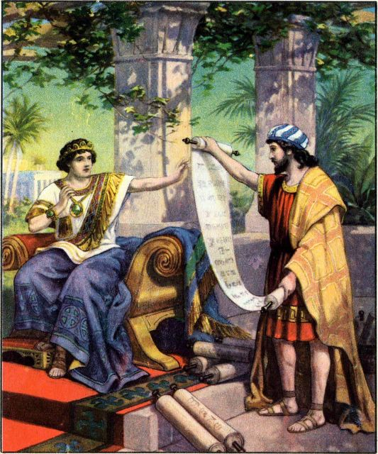
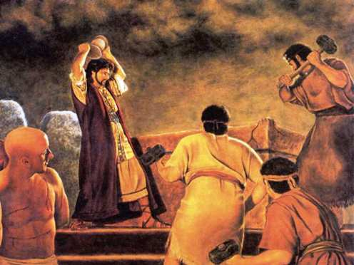
King Josiah

Slide 14
King Josiah
II Kings 22:1-2
¹Josiah was eight years old when he began to reign, and he reigned thirty and one years in Jerusalem. And his mother's name was Jedidah, the daughter of Adaiah of Boscath.

Slide 15
King Josiah
II Kings 22:1-2
²And he did that which was right in the sight of the LORD, and walked in all the way of David his father, and turned not aside to the right hand or to the left.

Slide 16
King Josiah
II Kings 22:8-11
⁸And Hilkiah the high priest said unto Shaphan the scribe, I have found the book of the law in the house of the LORD. And Hilkiah gave the book to Shaphan, and he read it.

Slide 17
King Josiah
II Kings 22:8-11
⁹And Shaphan the scribe came to the king, and brought the king word again, and said, Thy servants have gathered the money that was found in the house, and have delivered it into the hand of them that do the work, that have the oversight of the house of the LORD.

Slide 18
King Josiah
II Kings 22:8-11
¹⁰And Shaphan the scribe shewed the king, saying, Hilkiah the priest hath delivered me a book. And Shaphan read it before the king.

Slide 19
King Josiah
II Kings 22:8-11
¹¹And it came to pass, when the king had heard the words of the book of the law, that he rent his clothes.

Slide 20
Righteousness Exalts a Nation
Proverbs 14:34
Righteousness exalteth a nation: but sin is a reproach to any people.

Slide 21
God’s Word Is Sweeter than Honey
Psalm 119:103
¹⁰³How sweet are thy words unto my taste! yea, sweeter than honey to my mouth!

Slide 22
Luke 24:32
And they said one to another, Did not our heart burn within us, while he talked with us by the way, and while he opened to us the scriptures?

Slide 23
Do the same thing as King Josiah Did
Read God’s Word
Listen God’s Word
Respond to God’s Word
Seek understanding of God’s Word

