Slide 1
Your Passion For God’s Word
O God, thou art my God; early will I seek thee: my soul thirsteth for thee, my flesh longeth for thee in a dry and thirsty land, where no water is;
Psalm 63:1
September 20, 2009
Rev. David B. Hanson

Slide 2
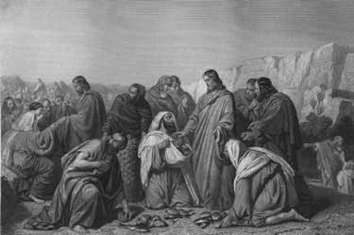
Why Jesus Feeds 4000 Men
Matthew 15:32
Then Jesus called his disciples unto him, and said, I have compassion on the multitude, because they continue with me now three days, and have nothing to eat: and I will not send them away fasting, lest they faint in the way.

Slide 3
How Do You Get Passion
Matthew 5:6
Blessed are they which do hunger and thirst after righteousness: for they shall be filled.
Passion means a strong liking or desire.
Most of the Christians have Bible boredom.
The Christians have clear instruction from the Word of God.
Desire
Bible
Reading
Studying

Slide 4
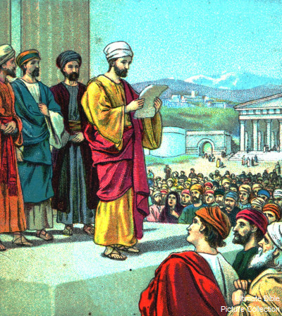
How Is Your Passion Revived
Psalm 119:154
Plead my cause, and deliver me: quicken me according to thy word.
Nehemiah 8:5-6
And Ezra opened the book in the sight of all the people; (for he was above all the people;) and when he opened it, all the people stood up:
And Ezra blessed the LORD, the great God. And all the people answered, Amen, Amen, with lifting up their hands: and they bowed their heads, and worshipped the LORD with their faces to the ground.

Slide 5
What Three Types of Christians Do
Common Christians
I Peter 2:2
As newborn babes, desire the sincere milk of the word, that ye may grow thereby:
Matured Christians
Hebrews 5:14
But strong meat belongeth to them that are of full age, even those who by reason of use have their senses exercised to discern both good and evil.
Practical Christians
II Timothy 2:15
Study to shew thyself approved unto God, a workman that needeth not to be ashamed, rightly dividing the word of truth.

Slide 6
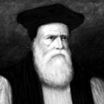
William Morgan
Born in Wales in 1545
Studied philosophy, mathematics and Greek at St. John College in Cambridge
Received BA and MA degrees
Spent seven years on Biblical studies
Received BD and DD
Ordained as a bishop in 1568
Translator of the first version of the whole Bible into Welsh from Greek and Hebrew in 1588
Died in 1604

